Slide 1
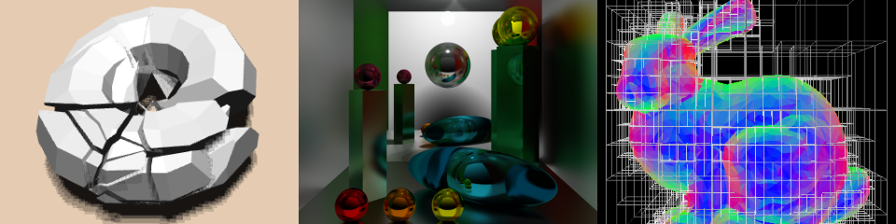
GPU Programming and Architecture: Course Overview
Patrick Cozzi
University of Pennsylvania
CIS 565 - Fall 2015

Slide 2
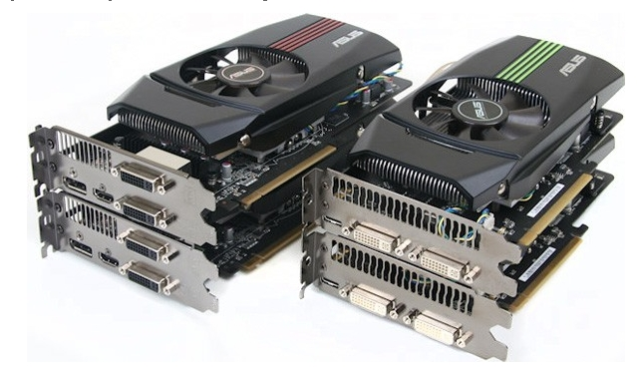
Lectures
Monday
6-9pm
Moore 212
Fall and Spring 2012 lectures were recorded
Attendance is required for guest lectures
Image from http://pinoytutorial.com/techtorial/geforce-gtx-580-vs-amd-radeon-hd-6870-review-and-comparison-conclusion/
Notes:
Lecture are optional, but everyone comes. Students even say they will stay longer because they don’t have class afterwards.
Even though the lectures are not required, come to class for the same reason that you shouldn’t work from home. Will you ever be promoted? Are you surrounding yourself by the best people you can find?

Slide 3


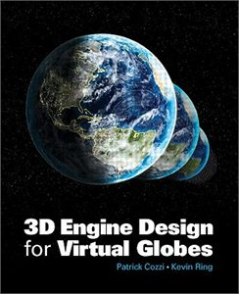









About Me
Patrick Cozzi
See http://www.seas.upenn.edu/~pcozzi/
Notes:
Cesium demos - http://cesiumjs.org/

Slide 4
About Me
Email
  pjcozzi+cis565@gmail.com
Twitter
  @pjcozzi
Office Hours
  By appointment

Slide 5
About Me
Not “Professor”, “Dr.”, “Mr.”, or “Sir”
Not even “instructor”
Perhaps “organizer”, “facilitator”, “coach”, “catalyst”, “enabler”, or “hobbyist”
CIS 565 is a series of projects with supporting lectures.
Notes:
Perhaps we are a sports team, and each project is an event I am preparing you with. I may bring in specialists, i.e., guest lectures, in some cases just like a football might bring in a defense specialist.
We design this course backwards from the final project. The final project is the purpose of the course, the regular projects provide breadth and a bit of depth to prepare you for the final project, and the lectures prepare you for the projects.

Slide 6
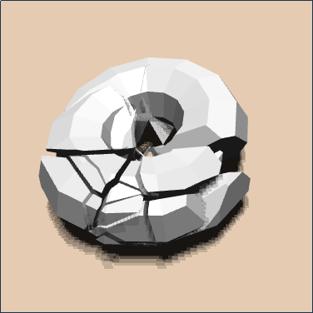
Teaching Assistant
Kai Ninomiya:
  gmail: kainino1+cis565@
Office Hours
  Tuesday, 6-7pm
  Friday 4-5pm
  Moore 103 (SIG Lab)
http://kainino0x.github.io/

Slide 7

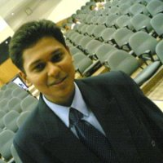
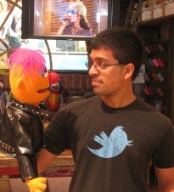



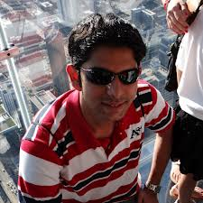
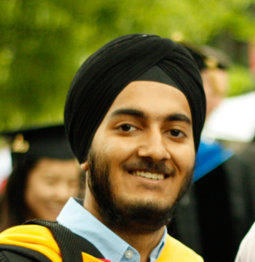
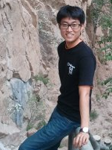
CIS 565 Hall of Fame
Jon
McCaffrey
Krishnan
Ramachandran
Varun
Sampath
Sean
Lilley
Ian
Lilley
Nop Jiarathanakul
Uriah Baalke
Collin Boots
Yuqin Shao
Sijie Tian
Rohith Chandran
Tiju
Thomas
Zakiuddin Shehzan Mohammed
Gundeep
Singh
Seunghoon Park
Are you next?
Notes:
There are so many students that I stopped updating this after Fall 2013.
Jon: System Design Engineer, NVIDIA (Android performance)
Krishnan: Character Simulations TD, Blue Sky Studios. Was able to explain how to GPU-accelerate simulations.
Varun: NVIDIA (video bios)
Sean: AMD (internship working on shadows). GPU Pro 4 chapter. Now at PGL doing procedural games.
Ian: AGI (internship working on materials)
Tiju: Microsoft Xbox
Shehzan: AccelerEyes (small GPU computing company; focus on performance)
Gundeep: Qualcomm (Android graphics drivers; tools for testing OpenGL ES 3.0)
Seunghoon Park: Had his CIS 565 OpenCL circular hough transform accepted to OpenCV
Nop Jiarathanakul, WebGL Autodesk
Uriah Baalke, Floored
Collin Boots, Final point-cloud project went into this thesis
Yuqin Shao, Mozilla Hacks article
Sijie Tian, Mozilla Hacks article
Rohith Chandran, ZeniMax Online, had deep graphics pipeline knowledge from implementing the rasterizer
Students whose futures were significantly influenced, e.g., jobs, etc., by CIS 565. Not based on grades.
Many more students that either I didn’t teach or have not heard from. (I didn’t teach Jon, but he was a TA). I feel that every student has gained something significant from this course, e.g., motivation, increased passion, etc.

Slide 8
Prerequisites
Passion for computer graphics
CIS 460/560. Preferably received an A
Strong C or C++
Also useful: CIS 371 or CIS 501
I don’t check prereqs
Notes:
I don’t officially check prerequisites; the path tracer project will.

Slide 9
Course Website
http://www.seas.upenn.edu/~cis565/
Schedule, reading, slides, projects, etc.

Slide 10
Google Group
https://groups.google.com/forum/#!forum/cis-565-fall-2015
Send email to cis-565-fall-2015@googlegroups.com
Be active; let’s build a course community
Notes:
Default to ask publically for the benefit of the entire class.
You’ll be involved in many communities throughout your career, let’s start now.

Slide 11

Used for course materials, projects, and the final project
Create an account:
  https://github.com/signup/free
Join our GitHub organization:
  https://github.com/CIS565-Fall-2015
Who is new to source control?
Notes:
Everyone needs to learn how to use source control. Learn best practices now while in school. Also better for collaboration and backups.

Slide 12

https://www.linkedin.com/groups/GPU-Programming-Architecture-6540935
Join our group for networking and job openings
  https://www.linkedin.com/groups/GPU-Programming-Architecture-6540935
Notes:
I frequently post GPU and graphics job openings to it. Employers come directly to me requesting CIS 565 students.

Slide 13
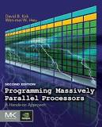

Completely Optional Books
Programming Massively Parallel Processors
2012, David Kirk and Wen-mei Hwu
Old draft: http://courses.engr.illinois.edu/ece498/al/Syllabus.html
Real-Time Rendering
2008, Tomas Akenine-Möller, Eric Haines, and Naty Hoffman
Notes:
If you get only one book, get Real-Time Rendering.
The best people I know read a lot.

Slide 14
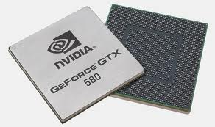
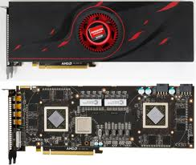
Course Topics
GPU – Graphics Processing Unit
Is it still just for graphics?
Images from http://www.ngohq.com/news/18784-nvidia-launches-geforce-gtx-580-a.html and http://gs7.blogspot.com/2011/09/amd-radeon-hd-6990-worlds-fastest.html
Notes:
The game industry is now larger than the movie industry. The demand for realistic graphics has driven innovation.

Slide 15
Course Topics
GPU architecture
GPU Architecture
Not to scale
Notes:
Focus GPU memory model and threading.
Differences, and now similarities, between GPU and CPU.

Slide 16

Course Topics
CUDA programming model for GPU Compute
CUDA
GPU Architecture
Not to scale
Notes:
Knowing GPU architecture is key to programming with CUDA.
Compute examples: image processing, computer vision, financial analysis, collision detection, path planning, etc.

Slide 17
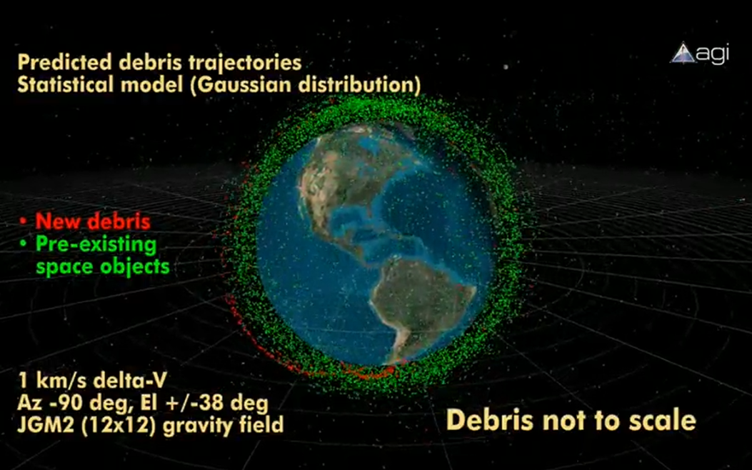
Course Topics
GPU Compute example: conjunction analysis
http://www.youtube.com/watch?v=dtT3pTh_q-8
Notes:
Hardware for a GPU solution is cheaper than a parallel CPU solution.

Slide 18
Course Topics
Parallel algorithms that form building blocks
Parallel Algorithms
CUDA
GPU Architecture
Not to scale
Notes:
Parallel reduction, scan (prefix sums), sorting, searching, and summed area tables.

Slide 19
Course Topics
Parallel Algorithms example: Scan
  Given:
  Compute:
  In parallel!
3
1
7
0
4
1
6
3
0
3
4
11
11
15
16
22

Slide 20
Course Topics
Historical and modern graphics pipeline
Parallel Algorithms
CUDA
Graphics Pipeline
GPU Architecture
Not to scale
Notes:
History of rasterization pipeline.
What the current generation pipeline looks like. Where is it going?

Slide 21
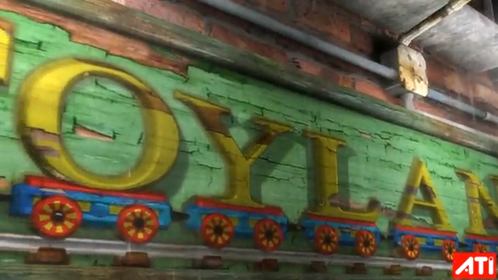
AMD Toyshop Demo
http://www.youtube.com/watch?v=LtxvpS5AYHQ
Notes:
http://developer.amd.com/media/gpu_assets/ToyShop-Eurographics_AnimationFestival.pdf
From 2006 (pre unified shader architecture, wow) – Radeon X1800 at 26-29 fps
Parallax Occlusion Mapping – self-shadows, perspective-correct: bricks, wood letters, sidewalks
28 MB vertex/index. 156 MB for (compressed) textures. 54 MB for framebuffers. Total 240 MB.
500 different shaders.
250 draw calls for 200-500K polygons and 0-22K particles
Post-processing effects for glow, blurry reflections, and rain
Water simulation on GPU using Euler integration (only SM 2.0!)

Slide 22
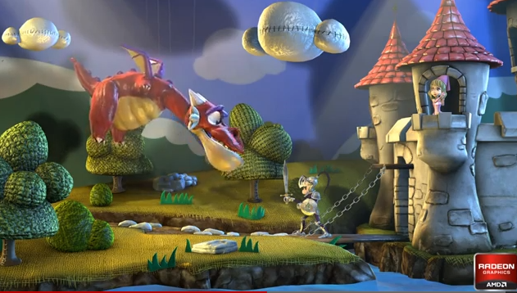
AMD Leo Demo
http://www.youtube.com/watch?v=zYweEn6DFcU
Notes:
http://developer.amd.com/Resources/documentation/samples/demos/pages/AMDRadeonHD7900SeriesGraphicsReal-TimeDemos.aspx
Also see - http://www.youtube.com/watch?v=s2y7e3Zm1xc
Complex materials AND many lights AND many light models.
Use compute to cull lights per tile. Forward shade per tile only with affecting lights.
One bounce global illumination effects by spawning virtual point light sources where light strikes a surface.
Multiple BRDF equations, realistic use of index of refraction, absorption based on wavelength for metals, etc.

Slide 23
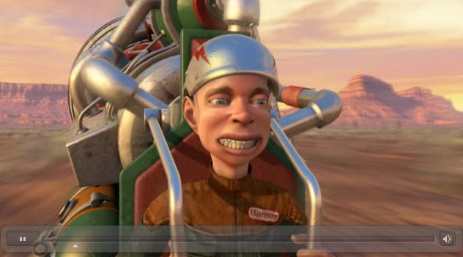
GPU Compute + Rendering
http://www.nvidia.com/object/GTX_400_games_demos.html
Notes:
Smoke - fluid simulation
Compute particles - bridge 1,000,000 particles
Terrain - Tessellation shader

Slide 24


Course Topics
WebGL
OpenGL compute shaders
Parallel Algorithms
CUDA
WebGL / OpenGL
Graphics Pipeline
GPU Architecture
Not to scale

Slide 25
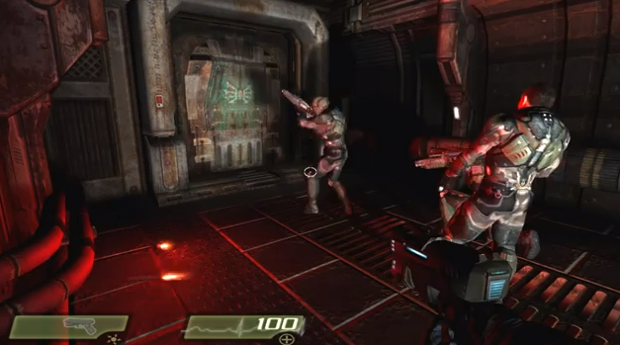
Turbulenz
http://www.youtube.com/watch?v=AJg_BmY9-8o
Notes:
http://www.shader.org/webglcamp/slides/s2_4.pdf
Quake 4 assets
1694 assets – compression and caching
353 lights, 346 particle systems – culling with portals and bounding-box trees
55 shading techniques, 451 materials – sort by technique and material
“huge number of dynamic lights and shadows, high quality animated skinned characters, particle systems with multiple stages, 2D GUIs and animations mapped onto 3D objects, and a great variety of materials and shading effects.”
“portal-based scene manager.”

Slide 26
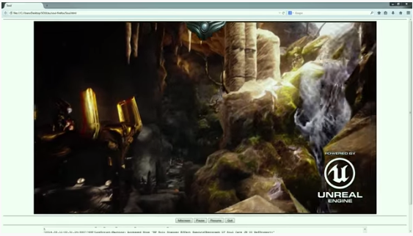
Unreal 4
https://blog.mozilla.org/blog/2014/03/12/mozilla-and-epic-preview-unreal-engine-4-running-in-firefox/

Slide 27
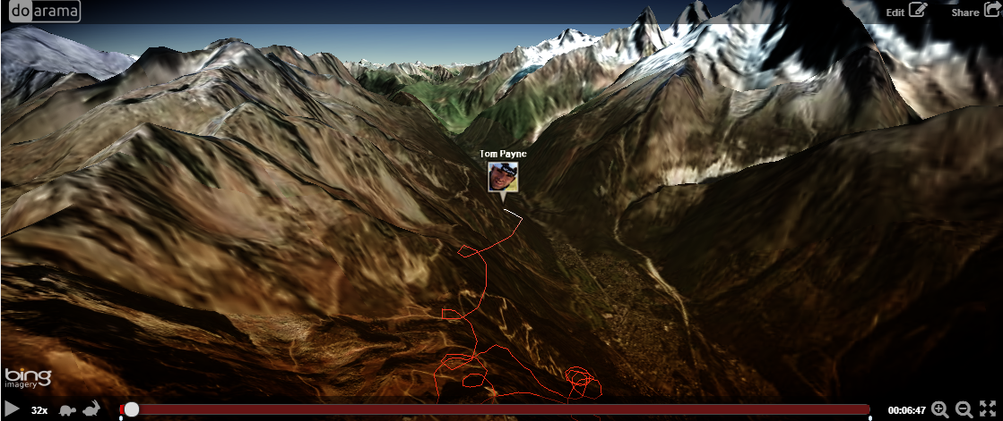
Doarama
http://www.doarama.com/

Slide 28
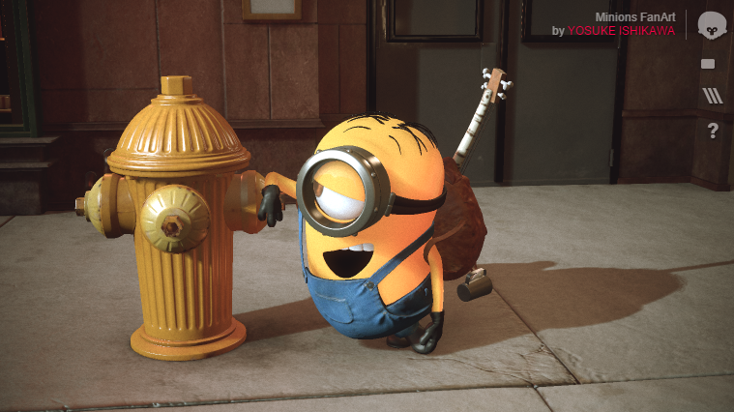
Marmoset Viewer
Notes:
PBR materials
IBL
http://www.marmoset.co/webglbof.html
http://www.marmoset.co/viewer/gallery

Slide 29
Course Topics
Mobile
Parallel Algorithms
CUDA
WebGL / OpenGL
Mobile
Graphics Pipeline
GPU Architecture
Not to scale
Notes:
And hopefully console architectures too…

Slide 30
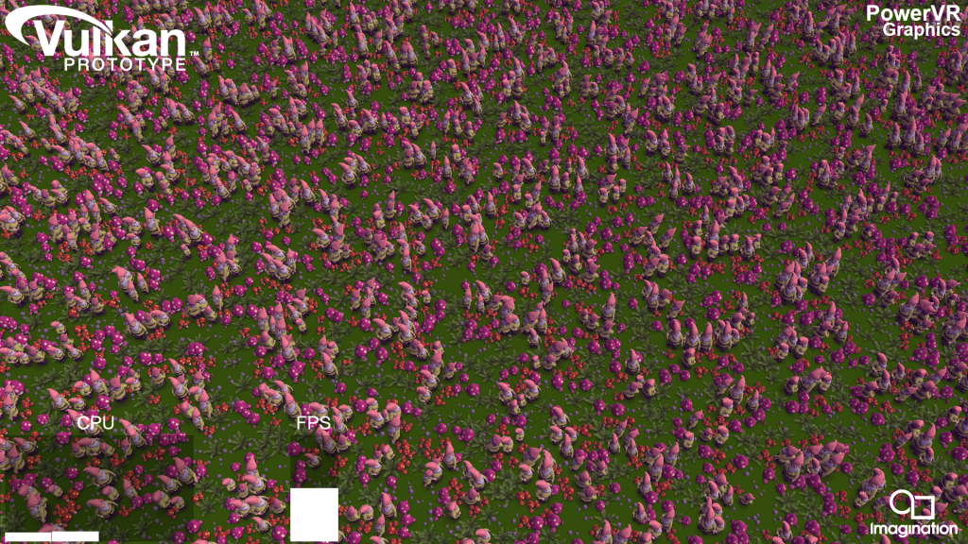

Course Topics
Vulkan
Parallel Algorithms
CUDA
WebGL / OpenGL
Mobile
Graphics Pipeline
GPU Architecture
Not to scale
Notes:
We’ll cover Vulkan if it is released this semester.
Video: https://www.youtube.com/watch?v=P_I8an8jXuM
Image and video from: http://blog.imgtec.com/powervr/trying-out-the-new-vulkan-graphics-api-on-powervr-gpus
Logo from https://www.khronos.org/news/logos

Slide 31
Course Topics
Performance!
Vulkan
Parallel Algorithms
CUDA
WebGL / OpenGL
Mobile
Graphics Pipeline
GPU Architecture
To scale!
Notes:
GPUs are about doing data-parallel problems quickly!
Walk clock performance. Not theoretical.

Slide 32
Course Topics
Topics are as time permits
We constantly adjust the schedule during the semester
Notes:
For example, we’ll replace a lecture with a guest lecture or a hackathon.

Slide 33
Guest Lectures
Shannon Woods, Google
Tarek Sherif, BioDigital
Dave Kotfis, Lockheed Martin
…

Slide 34
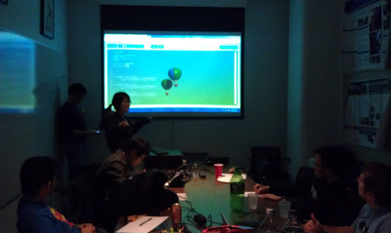
Hackathon
Cancel class, and code for prizes instead
Notes:
Fun. Practice intensity. Get exposure. Team building.
http://blog.virtualglobebook.com/2012/12/hackathons-in-classroom.html

Slide 35
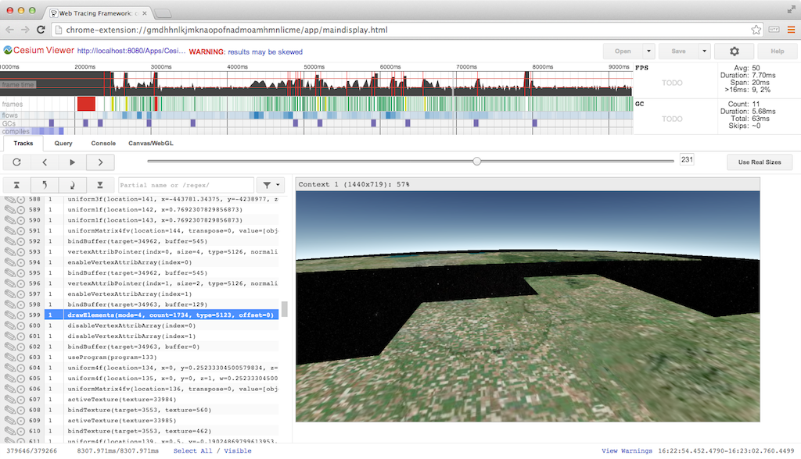
Profiling Lab
Profile open-source WebGL apps

Slide 36
Grading
Projects 50%
Final Project 50%
Final 0%
Notes:
Quest for knowledge vs. question for grades.
Some outstanding students don’t have great grades. Most students with great grades do well outside of school.
This is a pragmatic course about creating outstanding GPU/graphics developers. I don’t care if you can pass a test. No midterm. Mostly no written homework except performance analysis.

Slide 37
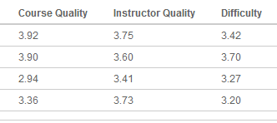
Projects
Not homework.
Intense.
Significantly more work than other courses.
Notes:
Rebrand homework as projects. Change culture. No one wants to do homework.
Numbers lie, but when the course gets harder, students like it more.

Slide 38
Projects
Each project has
  Coding
    Pick x of n, e.g., 3 of 5, plus open-ended parts
  Written performance analysis
  Write-up with screenshots and a video/demo
  Random in-class demos. Show, don’t tell.
Notes:
Replacing student presentations with in-class demos: live or video, not sure yet.
Practice writing and positioning your work.
Everyone needs to learn how to talk in front of a group and sell themselves. The demo will be the class following the due date.
In-class demos should focus on your unique features in the project – not the features everyone else also did.

Slide 39
Projects
Due at midnight on the due date
Submitted using GitHub
Late Policy
  Up to 1 week late: 50% deduction
Notes:
Time is EST. lol.

Slide 40
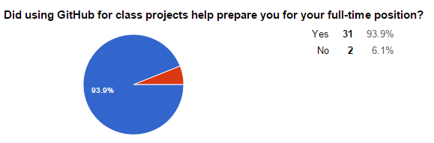
Alumni Survey Results - GitHub
Why didn’t it help?
  “I was familiar with git/github already. My employer uses centralized version control (Perforce).”
  “I am not working in a full-time position yet.”
Notes:
34 responses from CIS 565 alumni over six semesters (5 of which Patrick taught). The course is taught about once a year and has ~20 students.

Slide 41
Survey Results - GitHub
Why did it help?
  “Github is used extensively in the company I work for now. They also listed git as desired skill when recruiting for this position.”
Notes:
Most responses were similar to this. Companies are using git or GitHub, and are looking for students familiar it.

Slide 42

On Interviews…
  “Send me your code and then we’ll talk”
  - Christophe Riccio

Slide 43
Project Advice
Advice from Rich Geldreich (Boss Fight Entertainment, ex-Valve)
  Find (or create) an open source project that game devs use, and contribute to it in a very visible way. For example, we [Valve] recently hired the author/maintainer of the SDL library. Google actively recruits devs who write libraries they use. Intel hires open source driver devs that contribute to MESA.

Slide 44
Project Advice
Advice from Rich Geldreich
  Identify a need and fill it with an open source project (that uses a license liberal enough that devs can actually use it). For example, right now a lot of teams are trying to target OpenGL ES, OpenGL, and D3D9/11 and are struggling with how to write a single set of shaders that can be translated/compiled to all these targets.
  Become an authority on some topic and blog about it in a very
  visible/useful way.
Notes:
Common themes in Rich’s advice:
Find a real need
Be visible

Slide 45
Projects
Can be done as open source
  Build your code portfolio
Want to use private repos? Get a free edu account
  https://github.com/edu

Slide 46
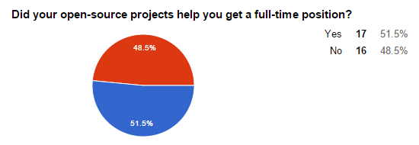
Survey Results – Open Source
Notes:
Keep in mind, it didn’t hurt the students who said No, and it helped 51.5%. I expect this to only increase as recruiting practices continue to change.
Several students also already had jobs before starting the course or received full-time positions based on their internships.

Slide 47
Survey Results – Open Source
“I have my personal website, and I have the github link on it. Employers are interested in the projects, and we had a great discussion. It's actually not about the coding part. I think code portfolio is not that popular when interviewing a candidate. The key part is still about the interview itself.”
Notes:
This quote is representative of many responses:
The project portfolio is useful: demos, videos
Employers generally don’t look at the code (or the student doesn’t realize it)
The interview itself is what matters

Slide 48
Survey Results – Open Source
“One of the companies I interviewed specifically went through my code samples on git and asked me questions based on that”
“A lot of companies are asking for my code sample on git.”
Notes:
Being asked about your own code is a great way to stack the odds in your favor.
I expect more companies to ask for code samples; as a hiring manager, I do.

Slide 49
Academic Integrity
http://www.upenn.edu/academicintegrity/
An academic integrity violation will result in the student receiving an F in this course
Get approval for all code you didn’t write yourself with the TA in advance
Notes:
Example: for a depth-of-field project, it is OK to use a third-party library to load models, but it is not OK to use a depth-of-field fragment shader found in google.
Copying from another student is not OK. If two students have the same exact code, and it is wrong…
Be ready to explain any part of your code.
Violating academic integrity is bad for you, your peers, and your university. It literally steals time away from making the course better for everyone.

Slide 50
Survey Results – Academic Integrity
Based on your experience, do you think open-source projects increase the chance of academic integrity violations?
  “It is possible but in my experience for such specialized courses like GPU programming, most students are in it to win it.”
  “I do not. If anything it makes them much more blatant and therefore high-risk.”
  “If students want to share code, they can regardless of policies”
  “I also think having rendered images and README files publicly viewable online is great motivation for current students who want to one-up students from previous years.”

Slide 51
Final Projects
Final Projects often become projects
  Path tracer
  Deferred shading
Notes:
Progress: A half-semester project for a team is now a single-person project for a week!

Slide 52
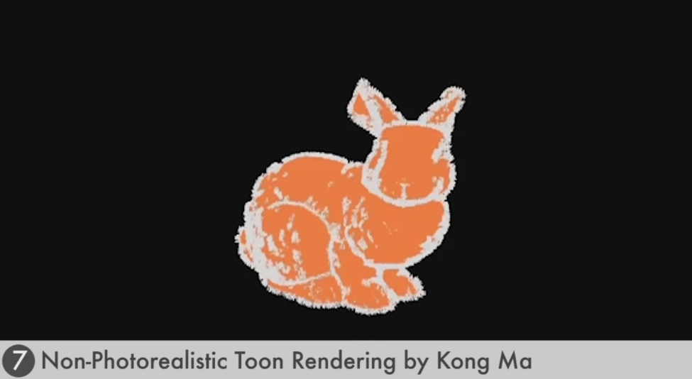
Fall 2012 Final Projects
http://cis565-fall-2012.github.io/index.html

Slide 53
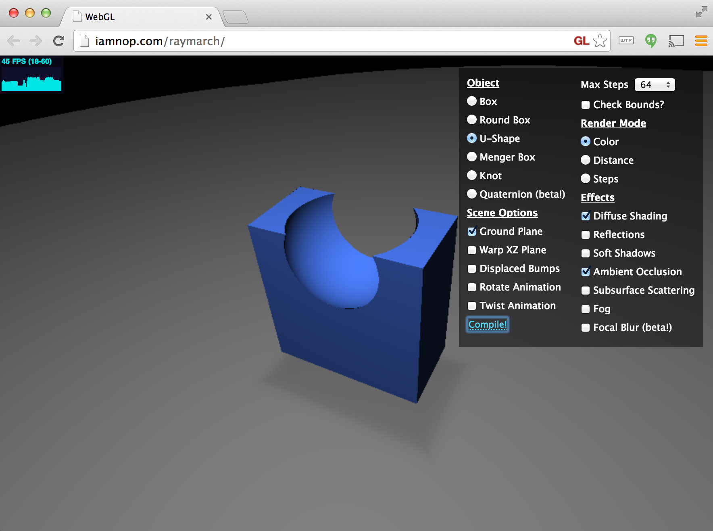
Ray Marching Distance Fields
Nop Jiarathanakul – CIS 565 Spring 2012
Notes:
Demo: http://iamnop.com/raymarch/
Blog: http://nopjia.blogspot.com/2012/04/final-deliverables.html

Slide 54
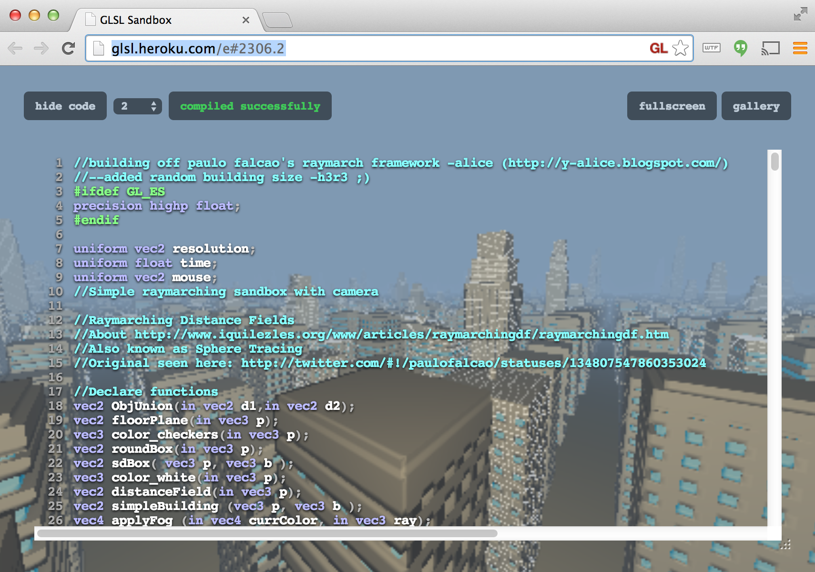
Procedural Infinite City
Alice Yang – CIS 565 Spring 2012
Notes:
Demo: http://glsl.heroku.com/e#2306.2
Blog: http://y-alice.blogspot.com/2012/04/final-submission.html

Slide 55
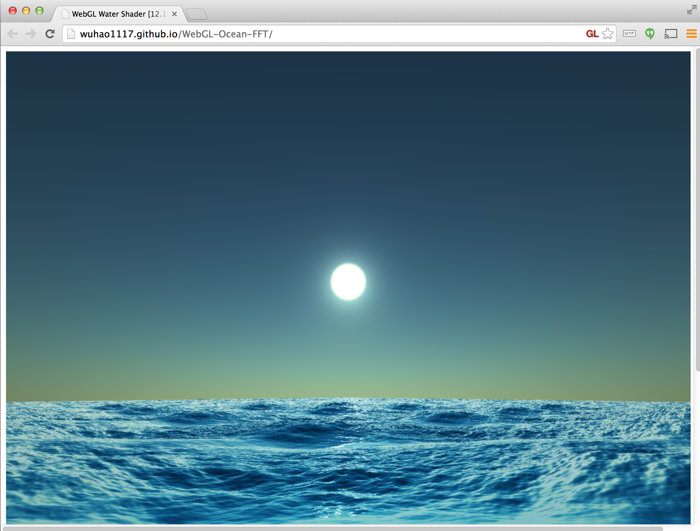
Water
Hao Wu and Guanyu He – CIS 565 Fall 2013
Notes:
Demo: http://wuhao1117.github.io/WebGL-Ocean-FFT/
Info: http://www.wuhao.co/webgl-fft-ocean.html

Slide 56
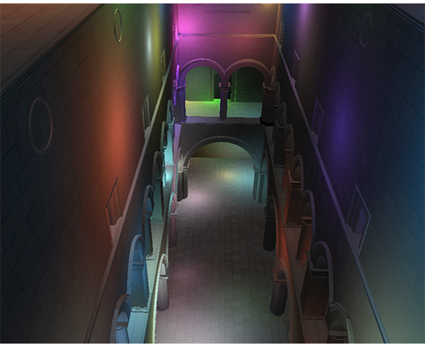
Deferred Shading
Sijie Tian and Yuqin Shao – CIS 565 Fall 2013
Notes:
Demo: http://sijietian.com/WebGL/deferredshading/index.html
Article: https://hacks.mozilla.org/2014/01/webgl-deferred-shading/

Slide 57
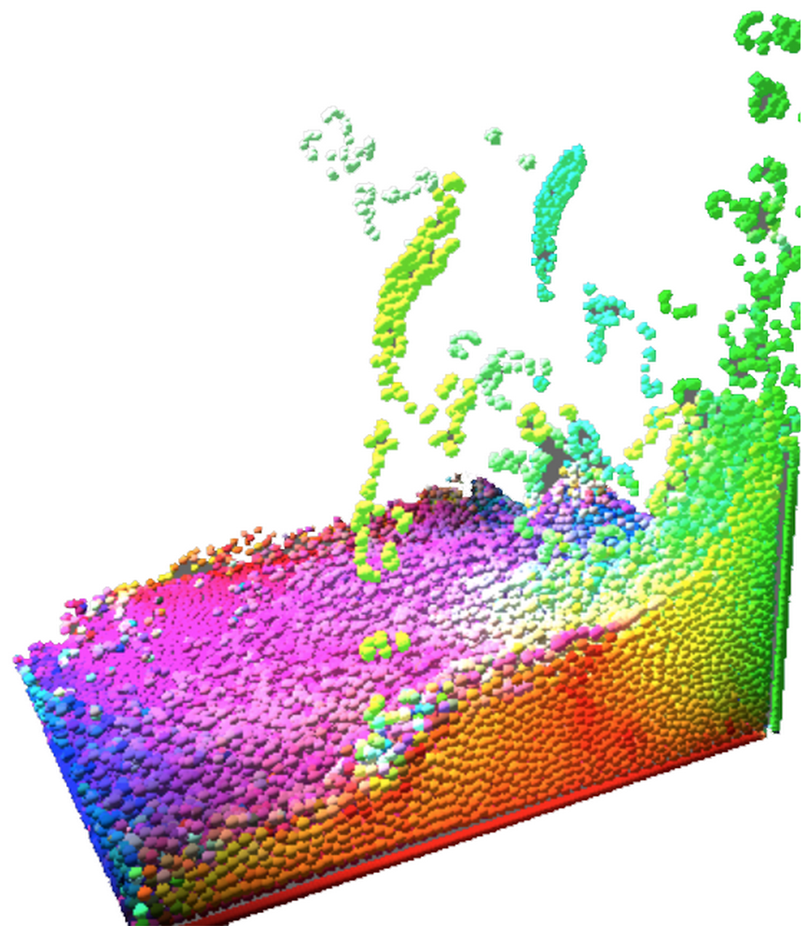
Particle Fluid Simulation
Alex Miller and Noah Lyons – CIS 700/003 Spring 2014
Notes:
Video: http://vimeo.com/103072321
Slides: https://docs.google.com/presentation/d/1JbPvI1NS7ExcDAGiAbU6cjhfUQzfhptHNNa48eK97oo/edit#slide=id.p
Sec3 engine: http://www.noahbenjaminlyons.com/sec3/
Demo: http://alexmiller12.github.io/WebGL-Fluids/
SPH using density and pressure.
Alex and Noah also implemented:
GPU-accelerated particle system with self-shadowing and order-independent transparency
Cascaded shadow maps with percentage closer filtering
Depth of field with smoothed foreground edges and variable width blur
Forward and deferred shading

Slide 58
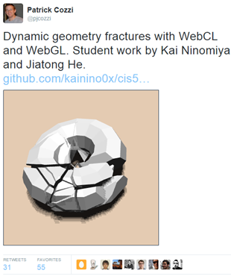
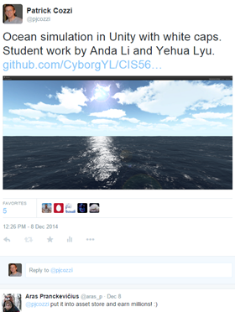
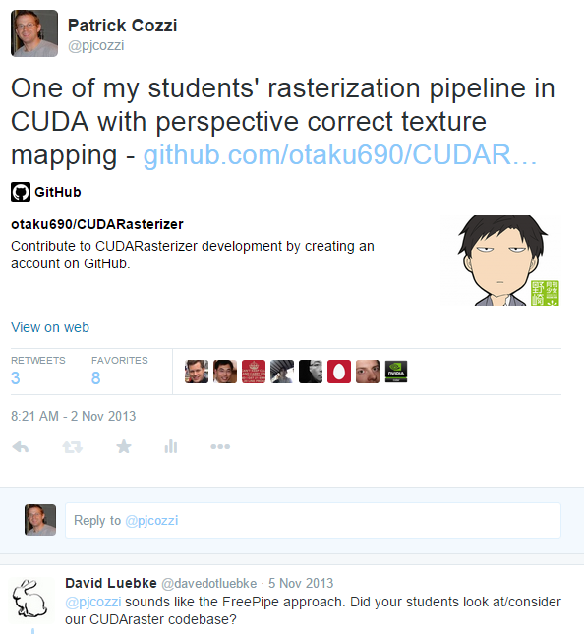
Twitter
Notes:
Exciting for students to have their work noticed outside of class and the university.
Sometimes, someone famous will notice.
Open source isn’t necessary for twitter, but it helps drive engagement.
Dynamic geometry fractures with WebCL and WebGL by Kai Ninomiya and Jiatong He, https://twitter.com/pjcozzi/status/542364663166824450
Ocean simulation in Unity by Anda Li and Yehua Lyu, https://twitter.com/pjcozzi/status/542007352925642753
Rasterization pipeline byCheng-Tso Lin, https://twitter.com/pjcozzi/status/396613045553623040

Slide 59
Intensity
Effort
Effort
Time
Time
Student
Pro boxer
Due date
Fight night
Notes:
What can we learn from boxing?
Not to scale; ignore integrating to see the area of the region under the curve.
Actually, we can learn a lot more from boxing: continuous feedback, intensity, etc.
Avoid burning out or making mistakes at the very end. Avoid unforeseen problems. “Early and often.”
I suggest to move the peek even sooner. Hit it hard right away. Line up your effort with office hours, so you can get help early and late.

Slide 60
Closing Thoughts
Progress – students surpass teaches
I want more than 2% impact
“Education is not the filling of a pail, but the lighting of a fire.” - W. B. Yeats
Notes:
If an undergrad degree is 40 courses, one course is 2.5%.
In 2007, I received an A+ in this course. The same work I did today would barely pass.

Slide 61
Reminders
Google Group
  Signup: https://groups.google.com/forum/#!forum/cis-565-fall-2015
LinkedIn
  Join our group: https://www.linkedin.com/groups/GPU-Programming-Architecture-6540935
GitHub
  Create an account: https://github.com/signup/free
  Change it to an edu account: https://github.com/edu
  Join our organization: https://github.com/CIS565-Fall-2015
Notes:
SIGGRAPH session on open-source projects in CIS 565: https://github.com/pjcozzi/Articles/tree/master/SIGGRAPH/2015

