Slide 1
Are you ready for the tutorial?
Grab a Worksheet and instructions
Did you do the pre-work?
  A. Do you have an account?
  B. Have you installed the tools?
  * SSH
  * omni
Jane
Jane Doe
Do you have an account?
GENI Portal is at:
  http://portal.geni.net

Slide 2
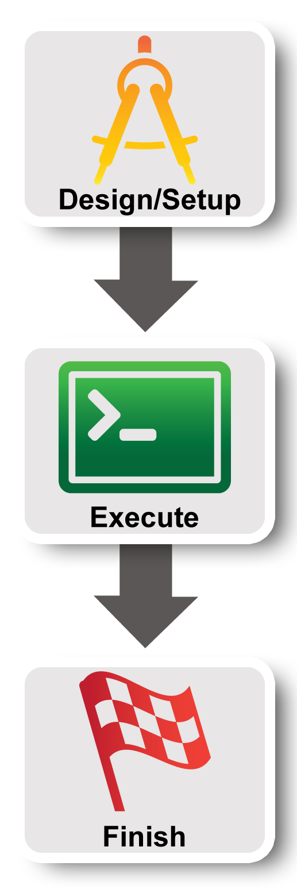
Lab Zero:
A First Experiment using GENI

Slide 3

Hands On Exercise
Do a Simple Experiment in GENI
Reserve two VMs connected at Layer 2
VM
VM
Layer 2
Notes:
There are three goals for today ….
First, jump right in and use GENI to do a very simple (layer 2) experiment

Slide 4
Understand GENI Terminology
project
slice
experimenter
resource
aggregate
Notes:
Second goal is to understand and use some GENI terminology.

Slide 5
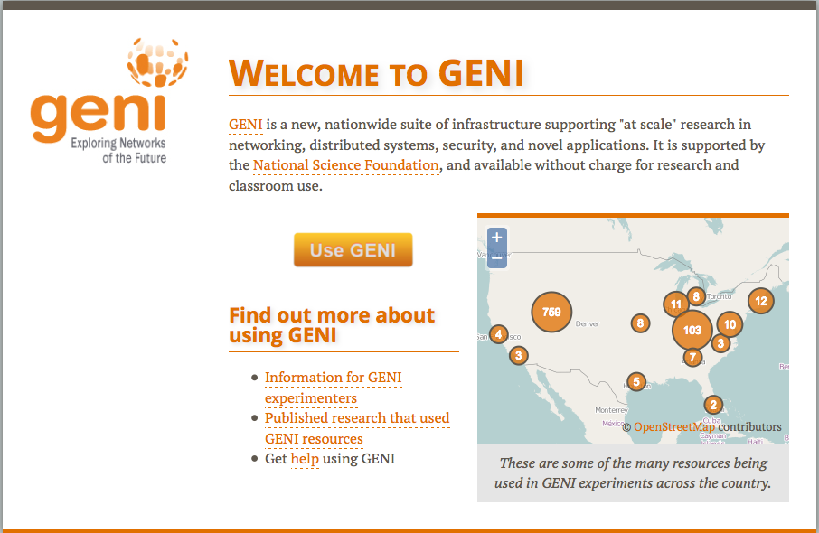
Use the GENI Portal and Flack
Notes:
Third goal is to learn how to use the GENI Experimenter Portal and Flack to do this experiment in GENI.
Note that the portal and Flack are built with GENI in mind so they reflect GENI terminology and concepts.

Slide 6
Use the GENI Portal and Jacks/jFed
Notes:
Third goal is to learn how to use the GENI Experimenter Portal and Flack to do this experiment in GENI.
Note that the portal and Flack are built with GENI in mind so they reflect GENI terminology and concepts.

Slide 7
Experiment Workflow
Part I: Design/Setup
Part II: Execute
Part III: Finish
Notes:
We’ve split the experiment into several parts. Before each of these sections, we’ll talk about the concepts and terms you will need for each section.
The logo on the left is intended to act as a guidepost to help you keep track of where you are.

Slide 8

The GENI Portal is…
A web-based tool for experimenters to manage experimenters, projects, and slices.
Includes simple tools to reserve resources.
More to come in the future.
Notes:
The GENI Experimenter Portal is fundamentally about managing experimenters, projects and slices (we’ll define these terms in a minute). But it also has tools for doing resource reservation.
(Note that new tools are being integrated with the Portal all the time.)

Slide 9
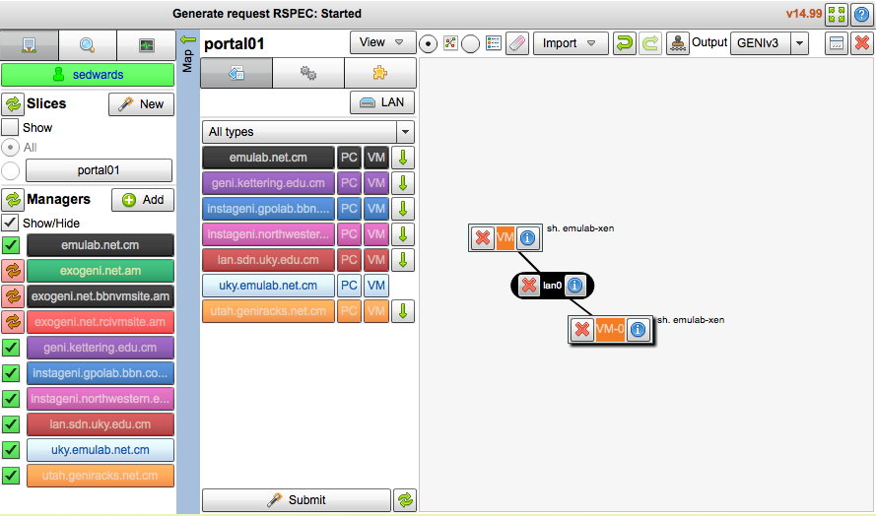
Flack is …
A graphical user interface (GUI) for:
  designing topologies in GENI
  reserving resources in GENI
Notes:
Flack is a tool that is integrated into the portal which provides a graphical user interface for designing and reserving topologies in GENI.

Slide 10
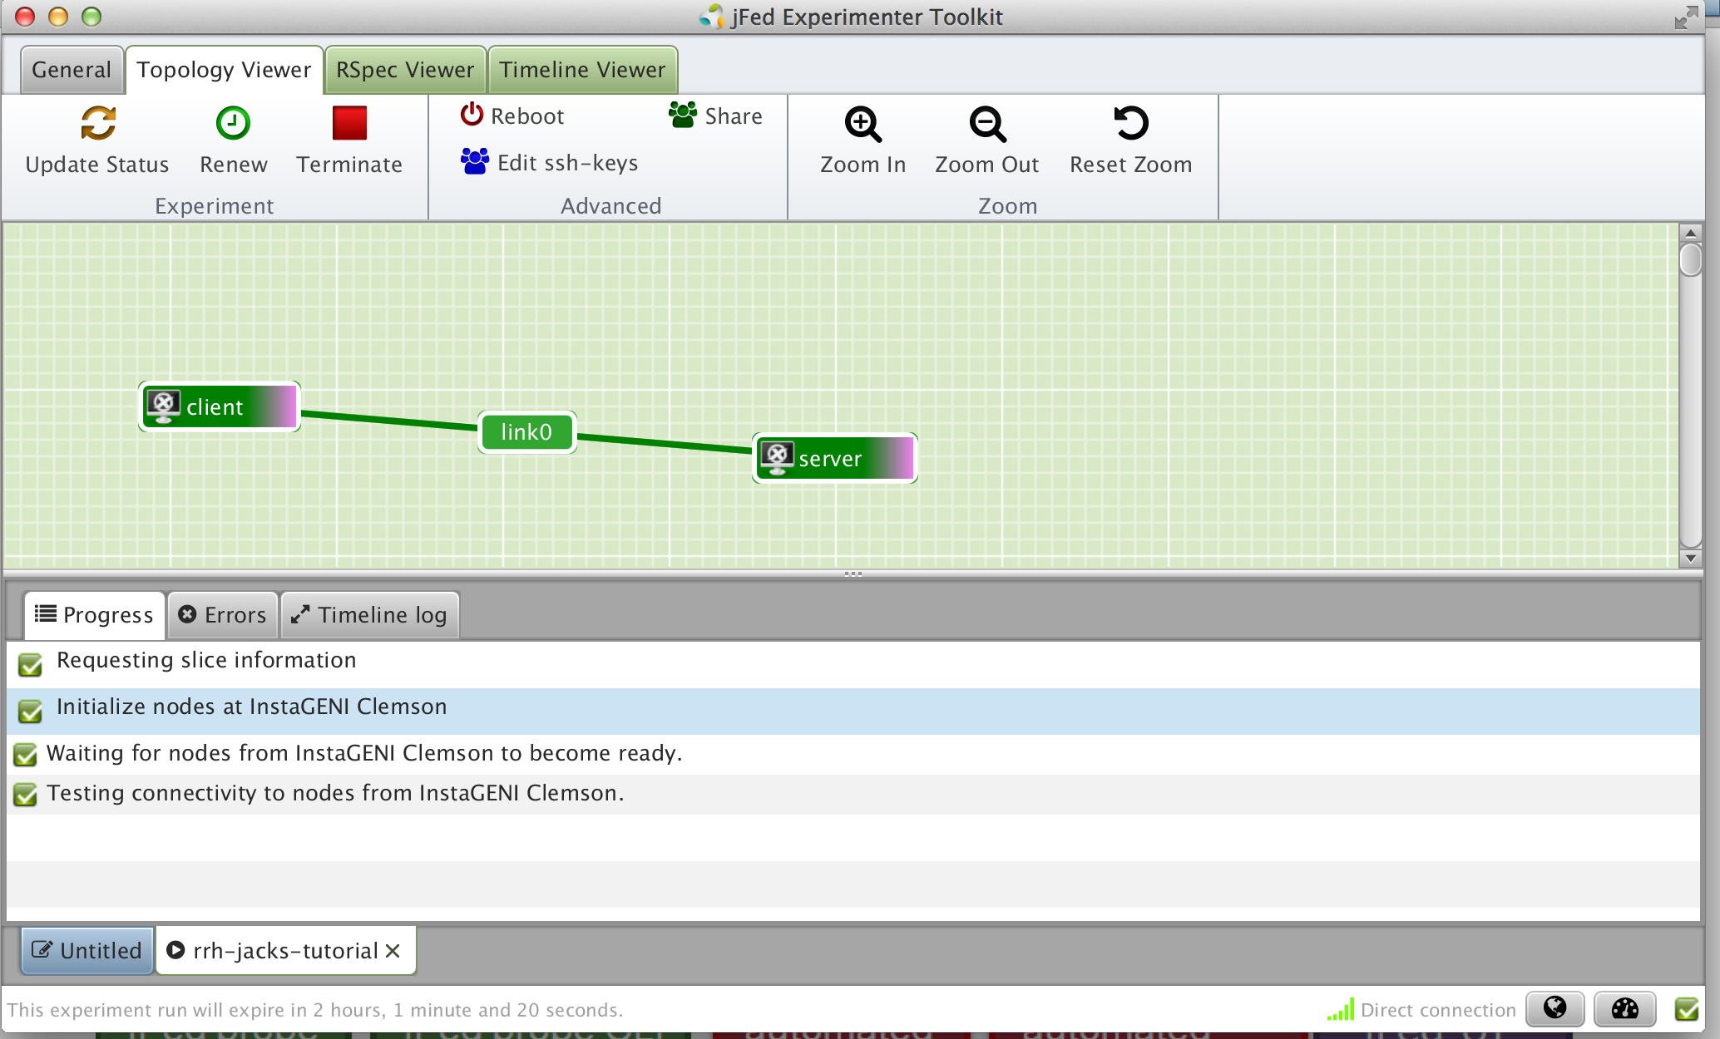
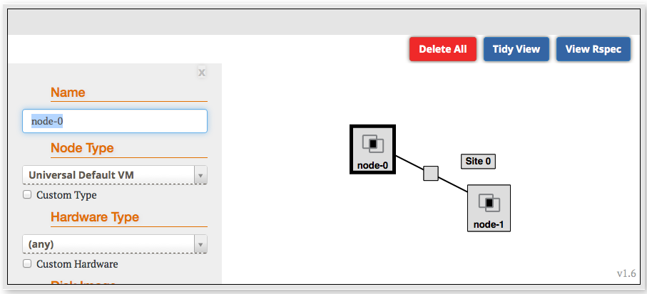
Jacks and jFed are …
Graphical user interfaces (GUIs) for:
  designing topologies in GENI
  reserving resources in GENI
Notes:
Flack is a tool that is integrated into the portal which provides a graphical user interface for designing and reserving topologies in GENI.

Slide 11

Experimenter
An experimenter is a researcher who uses GENI resources
Different types of experimenters have different roles and permissions:
Advisor vs Grad Student
Teacher vs TA vs Student
Experimenter
Notes:
An experimenter is a researcher who uses GENI resources.
Different experimenters will have different roles in GENI and therefore different permissions.
For example, …..

Slide 12
Projects
Project
Slice
Lead
Projects organize research in GENI
Members
  Projects contain both people and their experiments
A project is led by a single responsible individual:
the project lead
Today we will use a
project created for this class
Notes:
Experimenters can perform experiments in the context of a project.
Projects contain both people and their experiments. (Experiments are represented by slices, a term we will define in a few minutes.)
A project must have a single individual who is willing to take responsibility for what happens within the project. This person is called the project lead.
For our purposes today, we will use a project created for this class and the professor will be the project lead.

Slide 13
Creating Projects
Only project leads can create projects.
Project names are public, unique and permanent
A project may contain many experimenters; an experimenter may be a member of many projects
Projects have an optional expiration (e.g. for classes, tutorials)
For today’s exercise we will use a
project for this class
Notes:
In general, only project leads can create projects.
Project names are: public, global and permanent (choose carefully)
A project can contain many experimenters. And experimenters can be in many projects.
Projects have an optional expiration which can be used to support classes and tutorials.

Slide 14
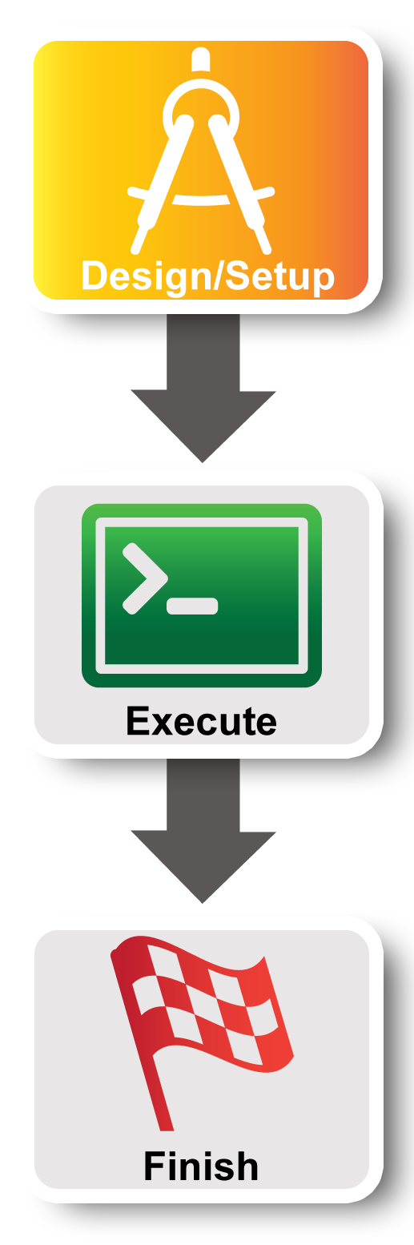
Experiment Workflow
Part I: Design/Setup
Part II: Execute
Part III: Finish
Notes:
Now we’re ready for part I. We will start by making sure we have the right access to GENI resources. This is mostly ** one-time setup **.

Slide 15
Part I:
Establish Management Environment
1 Pre-work: Design your experiment
2.1 Pre-work: Create a GENI account
2.2 Pre-work: Project lead (aka professor) adds you to project
  Project Name: GEC21
2.3 Generate and Download SSH Keypair
Notes:
First, if you haven’t already, we’ll log into the GENI Portal.
Second, the project lead should have already added you to a project.
Third, we will generate and download an SSH keypair.

Slide 16
Creating a GENI account
GENI Portal is at:
  https://portal.geni.net
Instructions for creating an account are:
http://groups.geni.net/geni/wiki/SignMeUp
Notes:
*** If you haven’t already logged in, please do so now. If you are having trouble please raise your hand and someone will come help you. ***
Anyone with an account at a supported identity provider can log in to the GENI portal but they will have no privileges. You must be a member of a project to do anything interesting.

Slide 17
Creating a GENI account
GENI Portal is at:
  https://portal.geni.net
Anyone with an account at a supported identity provider (usually your school or employer) can log in, but they will have no privileges
If you don’t have such an account, we will make you an account at the GPO Identity Provider
You must be a member of a project to do anything interesting
Notes:
*** If you haven’t already logged in, please do so now. If you are having trouble please raise your hand and someone will come help you. ***
Anyone with an account at a supported identity provider can log in to the GENI portal but they will have no privileges. You must be a member of a project to do anything interesting.

Slide 18


InCommon
Leverage InCommon for
single sign-on authentication
Experimenters from 304 educational and research institutions have InCommon accounts
For many experimenters:
  no new passwords
  familiar login screens
Notes:
The GENI Portal trusts identity providers who are members of the InCommon federation.
Students, faculty and staff will have an account provided by their school (for example, the University of Utah) which they use to access campus resources.
They can then use that account to login to GENI as long as their school is a member of InCommon (with some caveats). **This is exactly like using your Facebook or Google account to access other websites.**
For those experimenters, there are no new passwords. For all others, we are happy to make you an account on the GPO’s identity provider.

Slide 19
Expiration and renewal
project
slice
resource
resource
resource
(optional)
project
expiration time
resource
expiration time
slice
expiration time
now
slice expiration time ≤ project expiration time
each resource expiration time ≤ slice expiration time
each resource expiration time ≤ aggregate’s max expiration
In general, to extend the lifetime of your resource reservation, you must renew the slice and all resources
Notes:
GENI resources are provided by free on a first-come-first-serve basis. GENI uses a variety of expiration times to ensure resources are returned to the pool of available resources in a timely manner.
To start with, projects have an optional expiration time.
A slice created within that project has a slice expiration time that can not be any later than the project expiration time.
Resources reserved within that slice have an expiration time that can not be later than the slice’s expiration time. Moreover, different resources within the same slice may have distinct expiration times.
In general, to extend the lifetime of your resource reservation, you must renew both the slice and all resources within that slice.

Slide 20

Using SSH with a public/private keypair
Login to all GENI compute resources using
ssh with a private key
The public key is loaded onto the node when you reserve resources.
You provide the private key when you log into the node.
There are several ways to offer your private key to ssh.
No password!
You should never be prompted for a password to log into a GENI compute node.
If you are, something has always gone wrong.

Slide 21
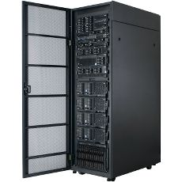

SSH with a password
*nix-based system (Windows behavior may vary)
local> ssh jdoe@remote.edu
jdoe@remote.edu’s password:
########
Welcome to remote!
jdoe@remote> exit
local> ssh jdoe@remote2.edu
jdoe@remote2.edu’s password:
########
ssh
Experimenter
User enters password
once for
each connection to each machine
Hash of password stored on each remote machine

Slide 22

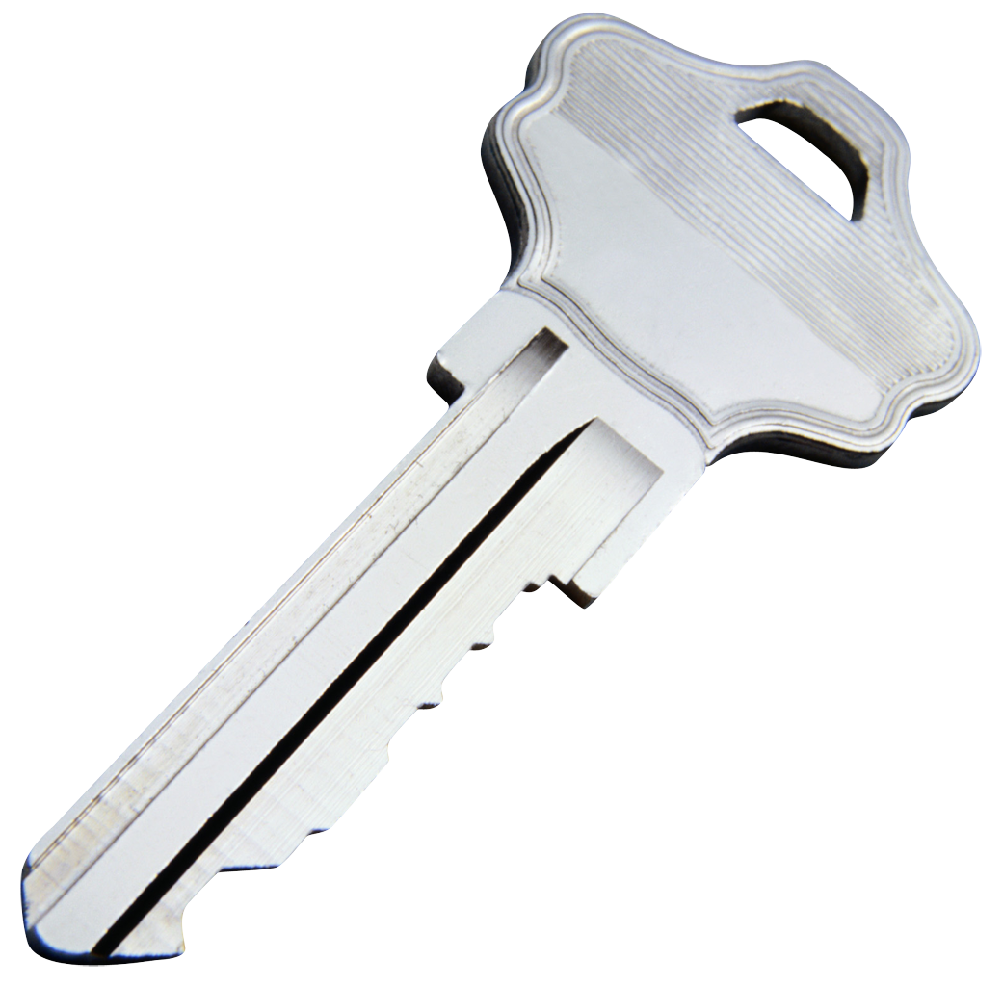
SSH with a private key
*nix-based system (Windows behavior may vary)
local> ssh-add ~/.ssh/id_rsa
Enter passphrase for ~/.ssh/id_rsa:
########
local> ssh jdoe@remote.edu
Welcome to remote!
jdoe@remote> exit
local> ssh jdoe@remote2.edu
Welcome to remote2!
jdoe@remote2> exit
local> ssh jdoe@remote3.edu
Welcome to remote3!
jdoe@remote3> exit
ssh
Experimenter
User enters passphrase to unlock private key
for all connections to
all machine
Private key is stored only on local machine
Public key is stored on each remote machine

Slide 23
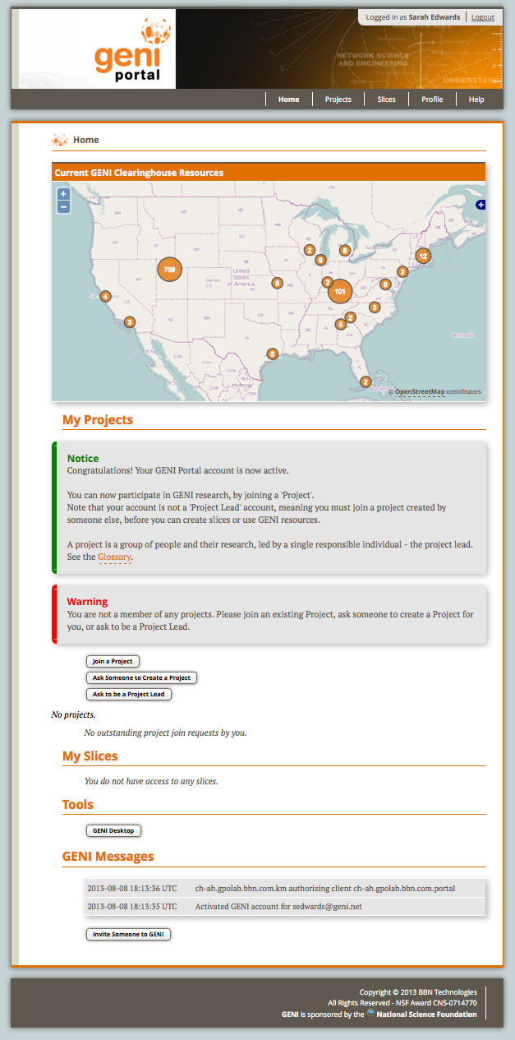
You are here
Profile
Help
Map
Projects
Slices
Tools
Log Messages
Notes:
If you haven’t already, login to the GENI Portal at https://portal.geni.net.
The Home page looks like this.
Going from top to bottom on the left, it lists all of the projects you are a member of and the slices you have. As well as a log of recent notable actions at the bottom.
The Home page has most of the features you will use day-to-day. You can always get back to the home page, by clicking “Home” in the toolbar in the upper right.
In addition the toolbar includes a Profile page which has many “occasional use” feature and a Help page with a link to a glossary and other helpful items.

Slide 24
2
Generate
SSH Keys &
SSL Certs
Login
Join Project
Notes:
You should have already logged in by now. And the tutorial leader should have added you to a project.
** If you can’t log in or aren’t in the project, please raise your hand. **
Now that everyone’s ready, please click the profile page to generate and download your SSH keys.
** Live portion: generate keys **

Slide 25
On your local machine…
2
> mv ~/Downloads/id_geni_ssh_rsa ~/.ssh/.
> chmod 600 ~/.ssh/id_geni_ssh_rsa
> ssh-add ~/.ssh/id_geni_ssh_rsa
Notes:
Download the keys generated by the portal. And configure SSH to use them.
These three commands:
* Move the private key generated by the portal into a standard location in the .ssh directory of the user’s home directory
* Changes the permissions on the file so it can’t be read by others
* Adds the ssh private key to your ssh agent.
** Live portion **

Slide 26

Resource
A resource is a piece of infrastructure
A resource can be real or virtual.
Resource specifications (aka. RSpecs) are used to describe and request resources.
Examples:
Compute: computer vs virtual machine (VM)
Wireline Network: VLAN or OpenFlow
Wireless: WiMAX
Notes:
A resource is something you can reserve -- like a computer or network. Resources can be real or virtualized.
The description of the resources you want to reserve are called a resource specification (abbreviated RSpec).

Slide 27
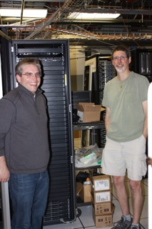
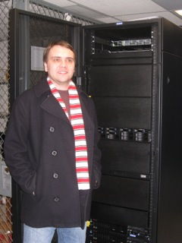


Aggregate
InstaGENI Rack
ExoGENI Rack
An aggregate manages a set of reservable resources
Aggregates include:
  GENI racks
  OpenFlow
  WiMAX
Notes:
An aggregate manages a set of available resources.
The GENI racks contains aggregates advertising compute and network resources.

Slide 28
Slice
A slice is a container of resources used in an experiment.
A slice can contain resources from one or more aggregates
A slice is in a single project
A slice has an expiration
Slice names are public, reusable and unique (within a project)
Notes:
A slice is a container for the resources you are using in your experiment.
A slice usually contains resources from multiple aggregates. A slice belongs to a single project and has an expiration. And slice names are unique within a project (as of mid-November 2013).

Slide 29

Putting it all together
project
Lead:
Member:
Experimenter
(aka Professor)
Experimenter
(aka Student)
slice
aggregate
resource
resource
Layer 2
Notes:
29
For today’s experiment we are reserving two resources which are VMs.
We are reserving those VMs at a single aggregate.

Slide 30
Part I continued:
Obtain Resources
slice
VM
VM
Layer 2
3.1 Create a slice
3.2 (optional) Renew your slice
3.3 Reserve two VMs at on aggregate
3.4 Check Whether VMs are Ready to be Used
Notes:
First, we will create a slice.
Second, we will optionally renew the slice.
Third, we will reserve resources at two aggregates. There is real work happening here as the nodes are reserved.
Fourth, we’ll determine if the virtual machines have booted and are ready for use.

Slide 31
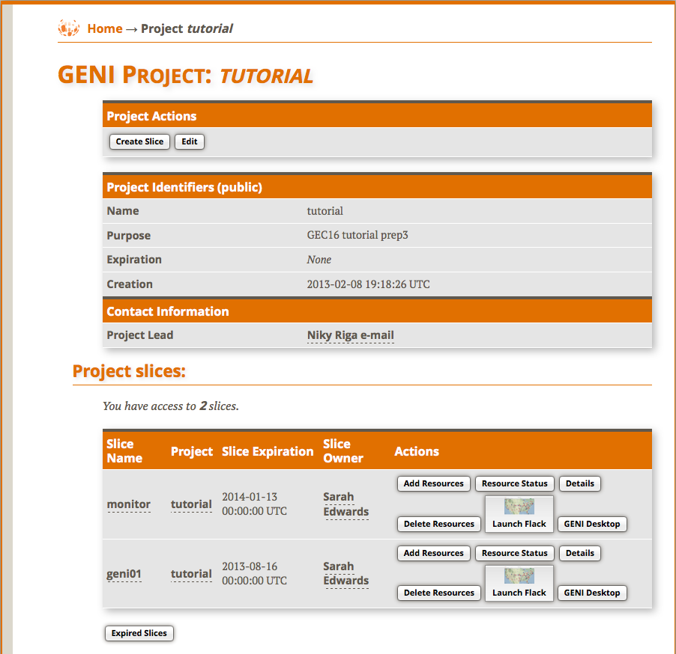
3.1
Create Slice
Notes:
Now that everyone is a member of the project, let’s click on the project page (you may need to reload your home page).
Now we all need to create a slice using the name XXXX.
** Live: create slice **

Slide 32
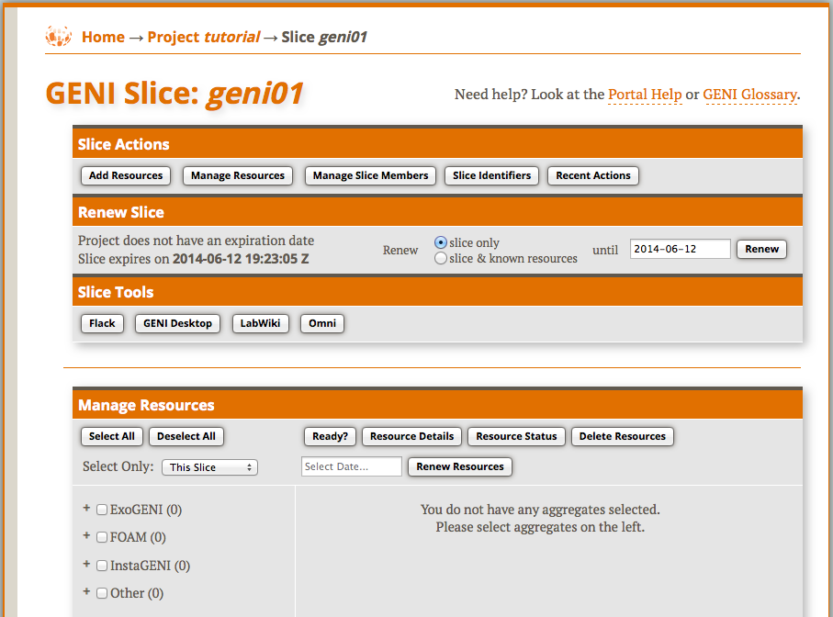
3.2
Extend slice expiration
Notes:
Next we will renew the slice to extend the initial expiration time for the resources.

Slide 33
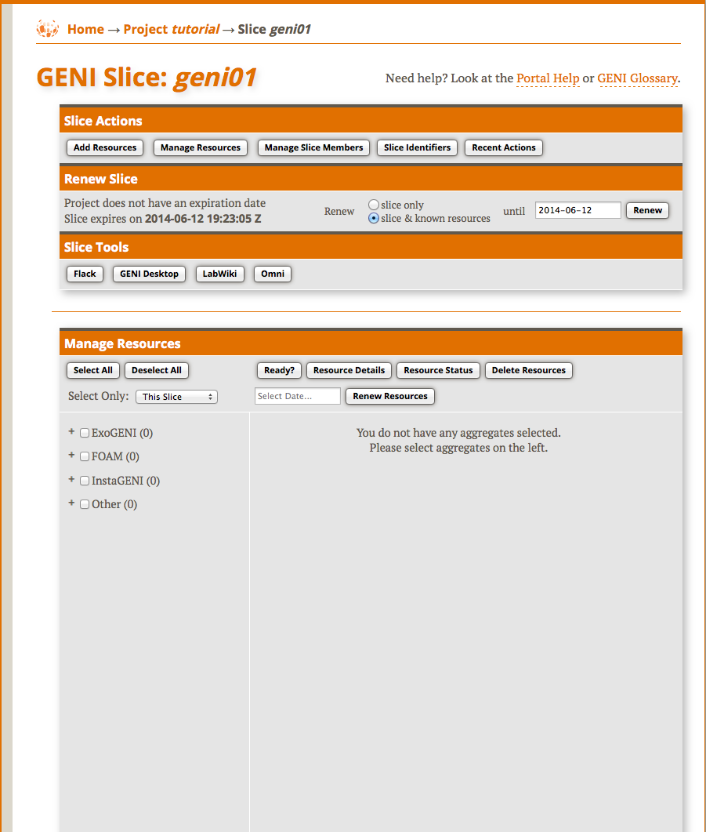
3.3
Launch
Flack
Notes:
Next we will reserve resources …..
Today we will reserve resources using Flack. So let’s launch that. This may take a minute.

Slide 34
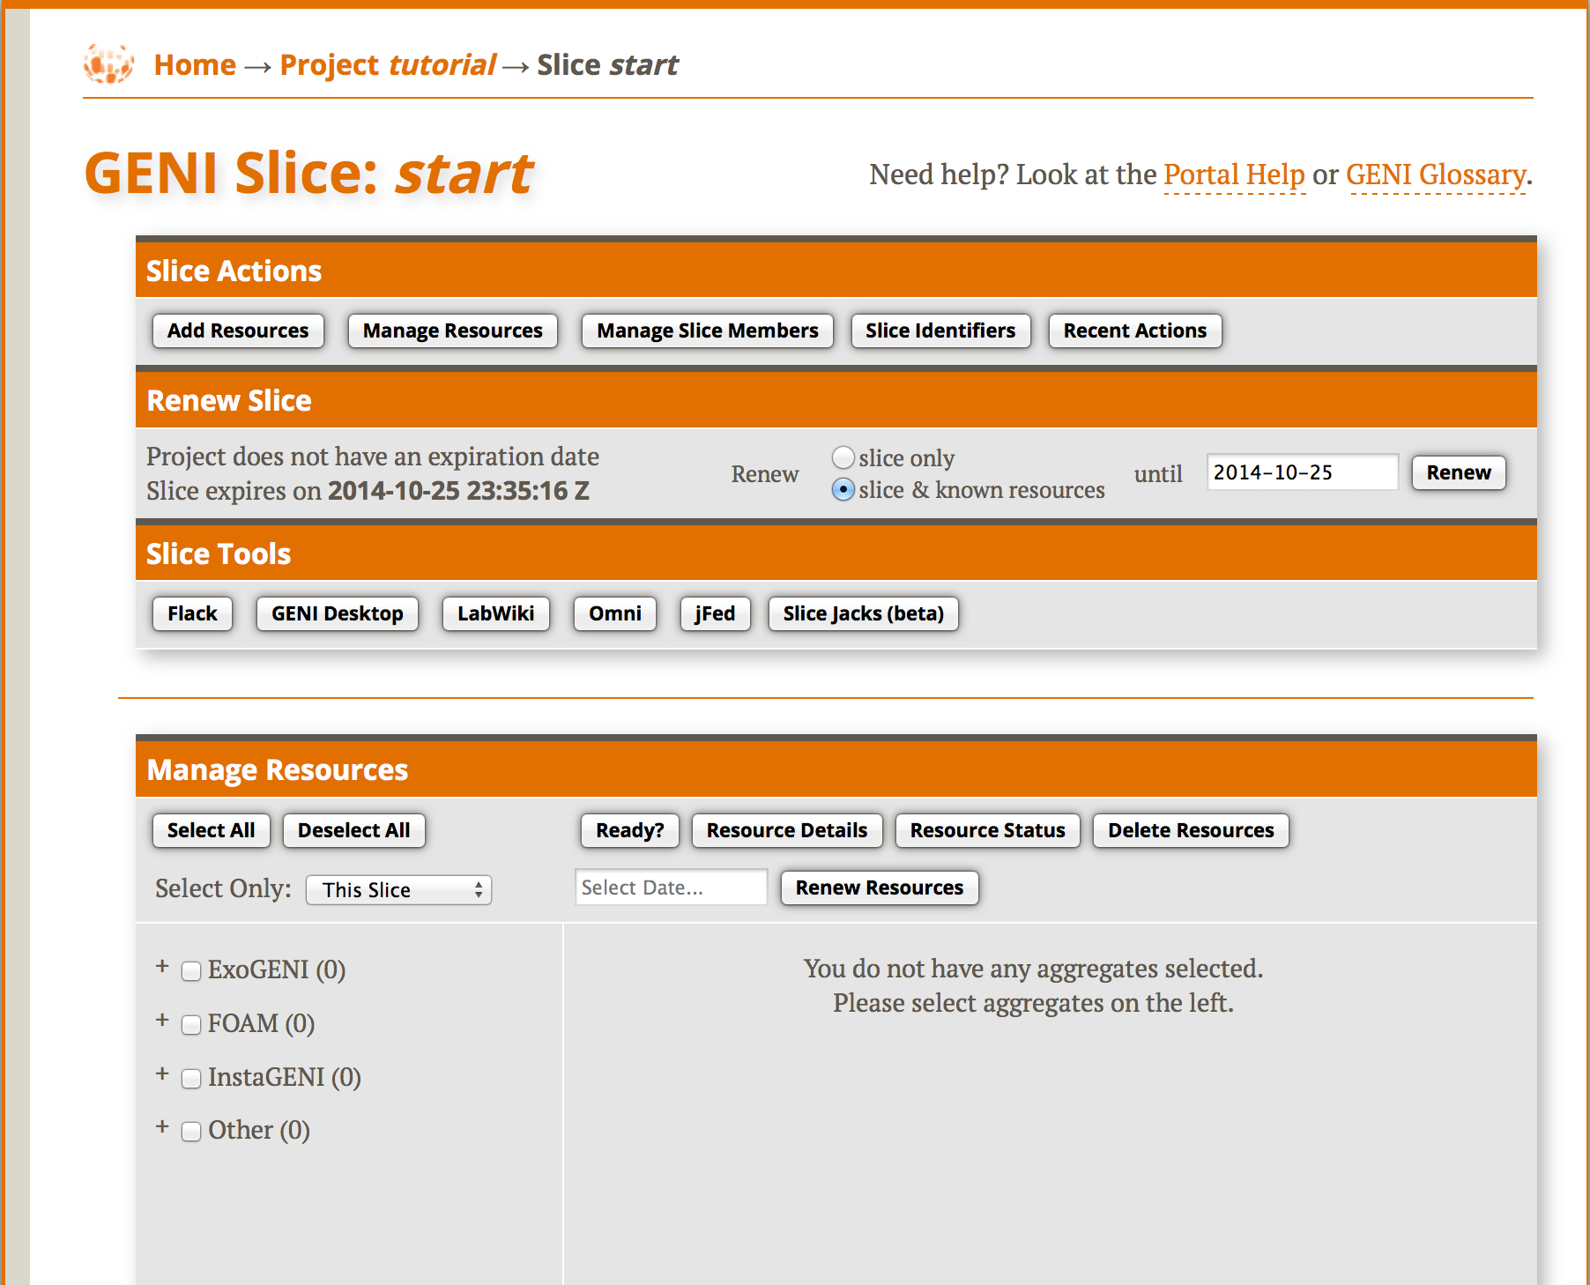
3.3
Launch
tool
Notes:
Next we will reserve resources …..
Today we will reserve resources using Flack. So let’s launch that. This may take a minute.

Slide 35
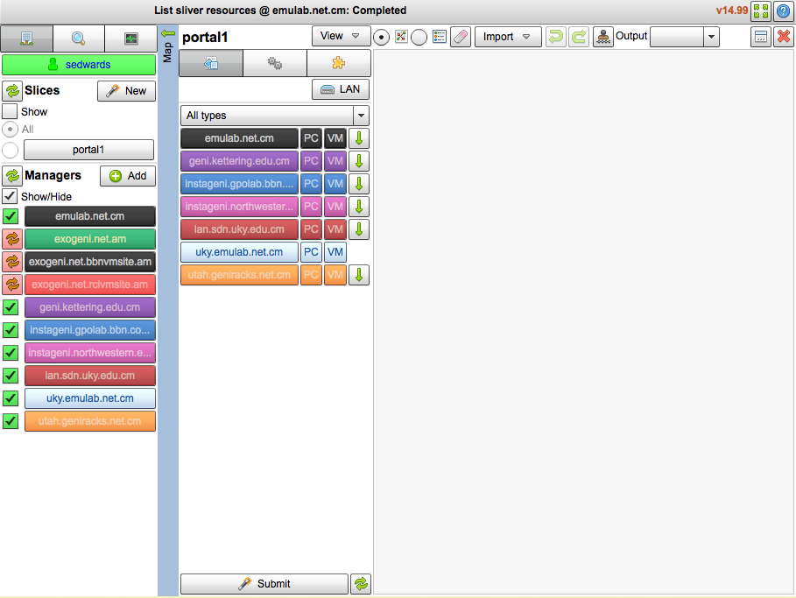
3.3
username
slice name
all available
aggregates
Launch
Flack
Notes:
Once Flack is loaded you should be able to see your username, slicename and a long list of aggregates.

Slide 36
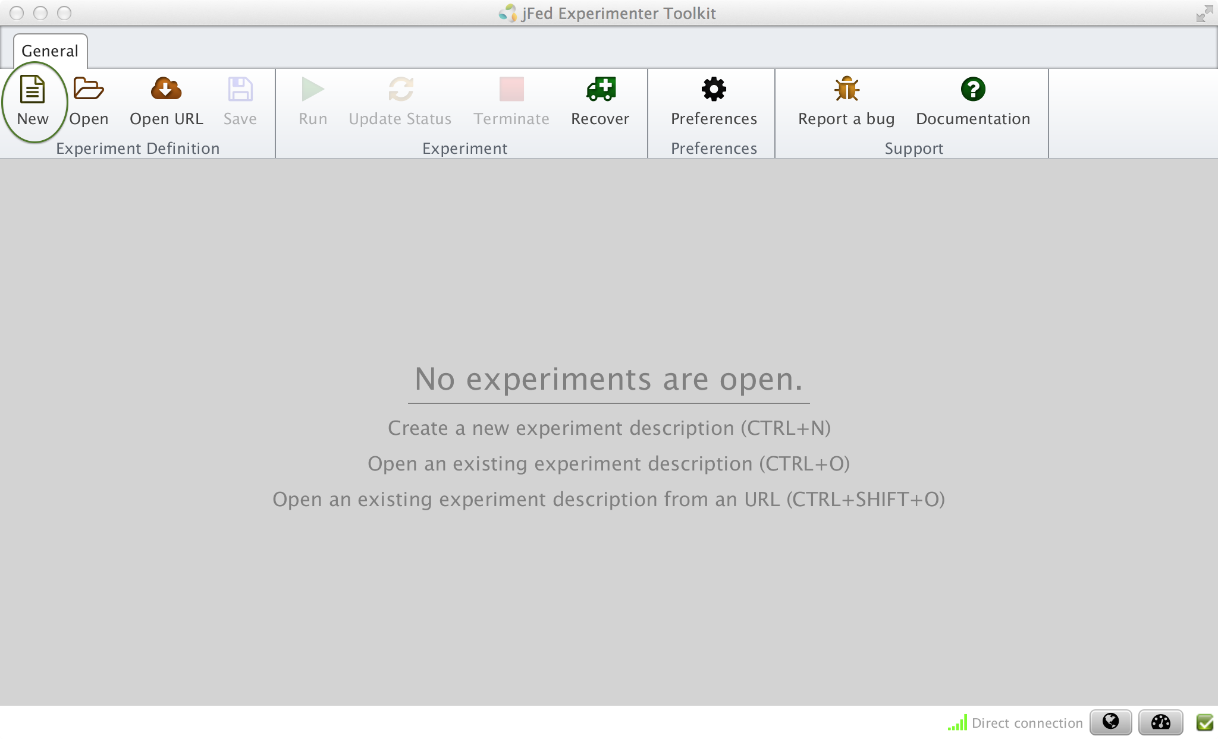
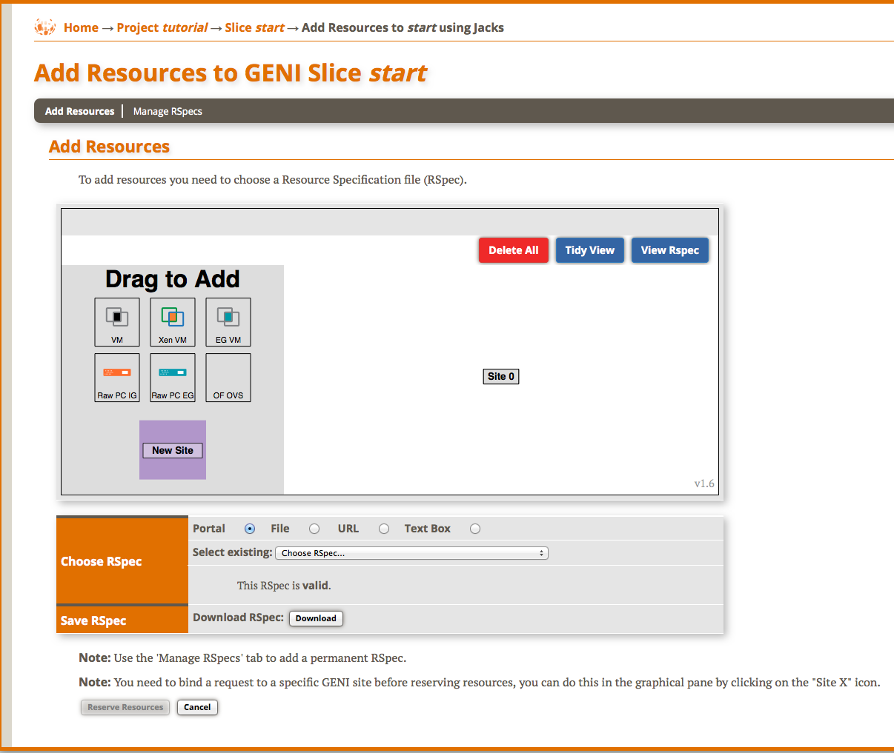
3.3
Launch
Tool
Notes:
Once Flack is loaded you should be able to see your username, slicename and a long list of aggregates.

Slide 37
3.3
Draw two VMs connected by a link
Notes:
Find the aggregate listed on your worksheet.
Click the VM box next to that aggregate and drag it onto the canvas. Repeat.
Now click near one of the VM boxes on the canvas, then click and drag towards the other VM. Release when you reach the other VM. You should now see a line and a box representing a link connecting the two VMs.

Slide 38
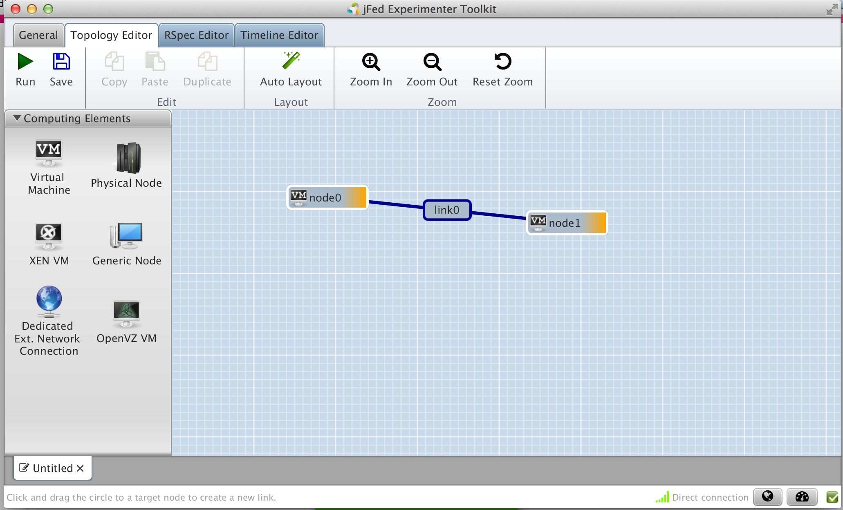
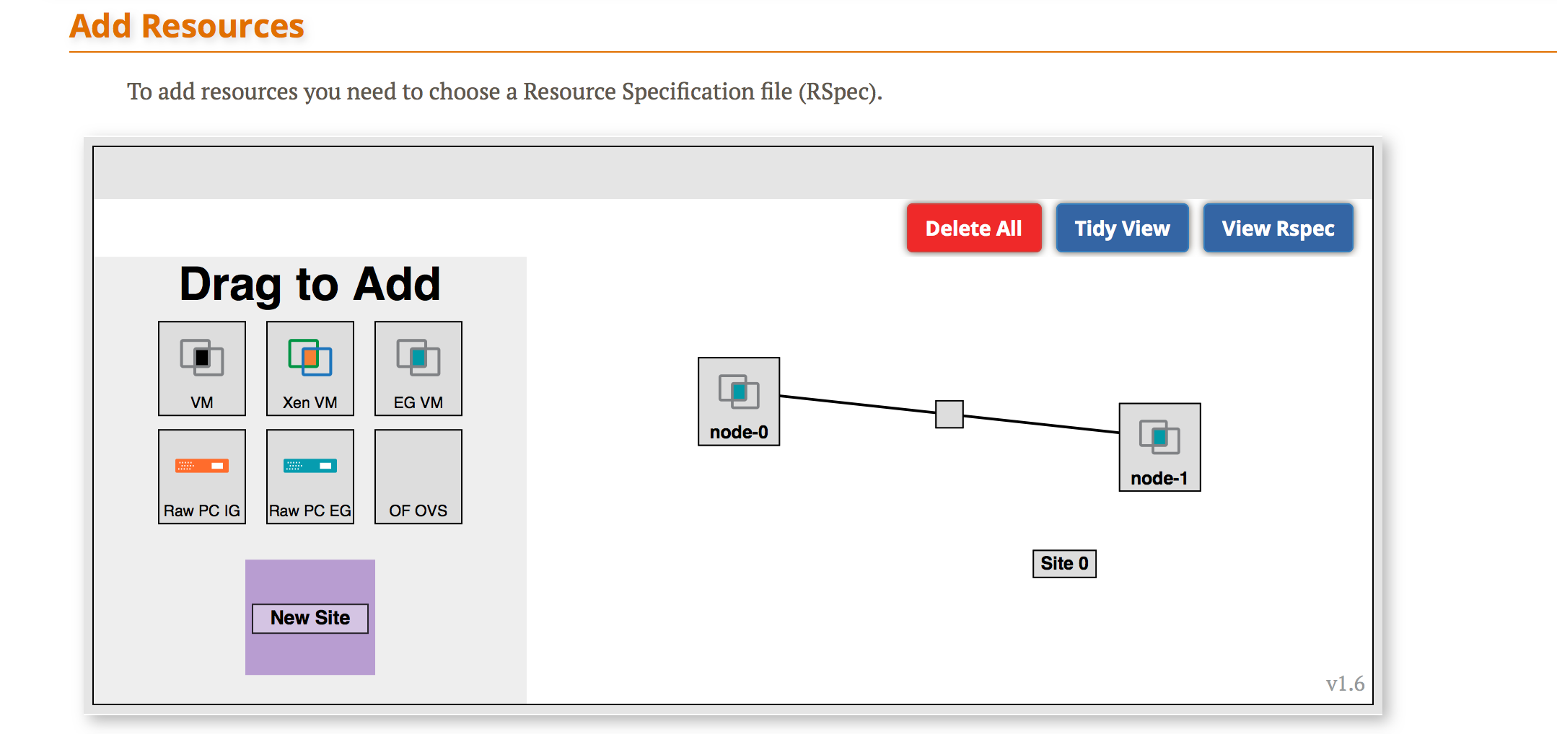
3.3
Draw two VMs connected by a link
Notes:
Find the aggregate listed on your worksheet.
Click the VM box next to that aggregate and drag it onto the canvas. Repeat.
Now click near one of the VM boxes on the canvas, then click and drag towards the other VM. Release when you reach the other VM. You should now see a line and a box representing a link connecting the two VMs.

Slide 39
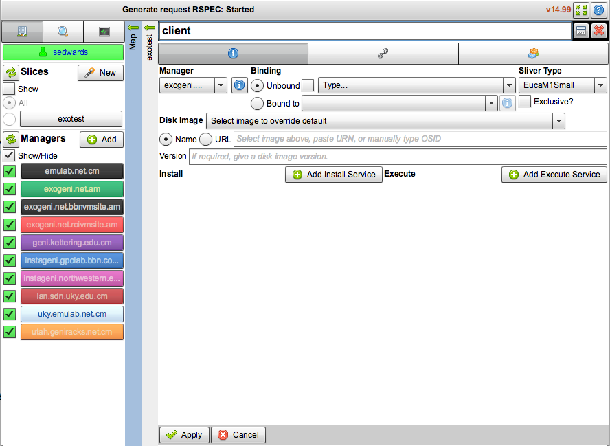
3.3
Change names of VMs
Notes:
Now change the name of the VMs by clicking on the “i” in a circle and editing the name in the pop up.
Make one VM “client” and the other “server”.

Slide 40
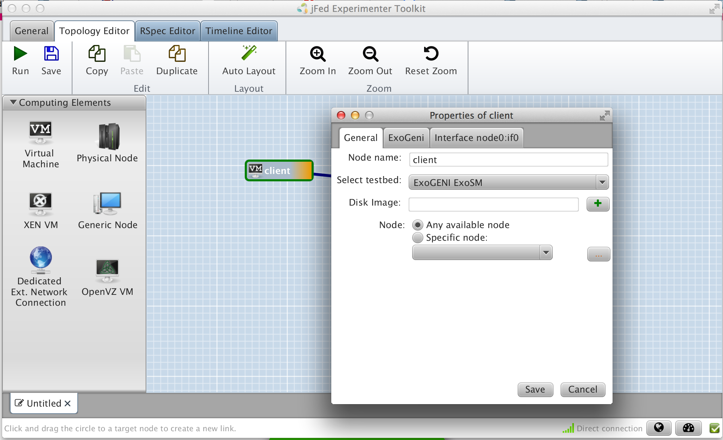

3.3
Change names of both VMs
Notes:
Now change the name of the VMs by clicking on the “i” in a circle and editing the name in the pop up.
Make one VM “client” and the other “server”.

Slide 41
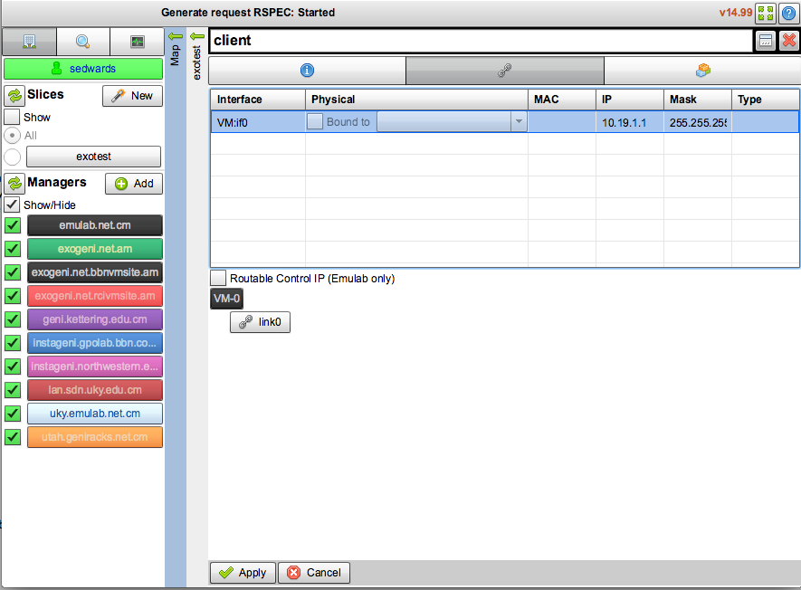
3.3
Set IP and mask of interfaces
Notes:
Now change the name of the VMs by clicking on the “i” in a circle and editing the name in the pop up.
Make one VM “client” and the other “server”.

Slide 42
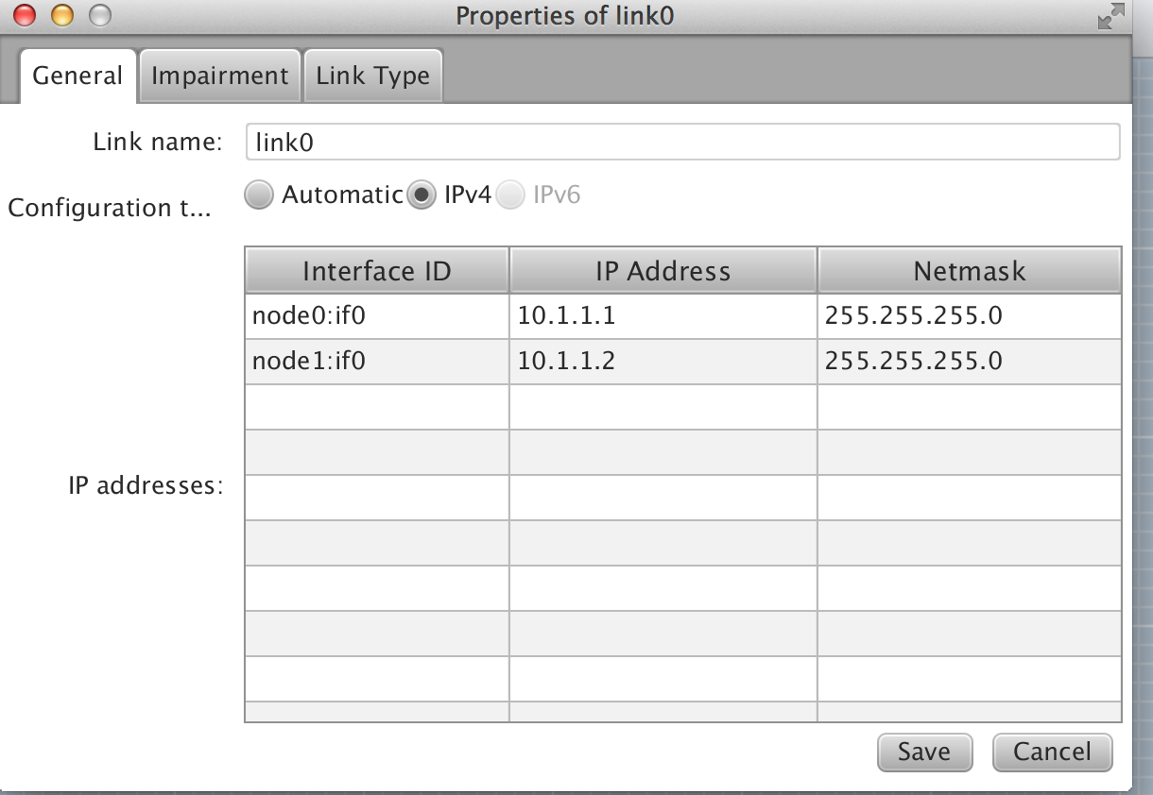
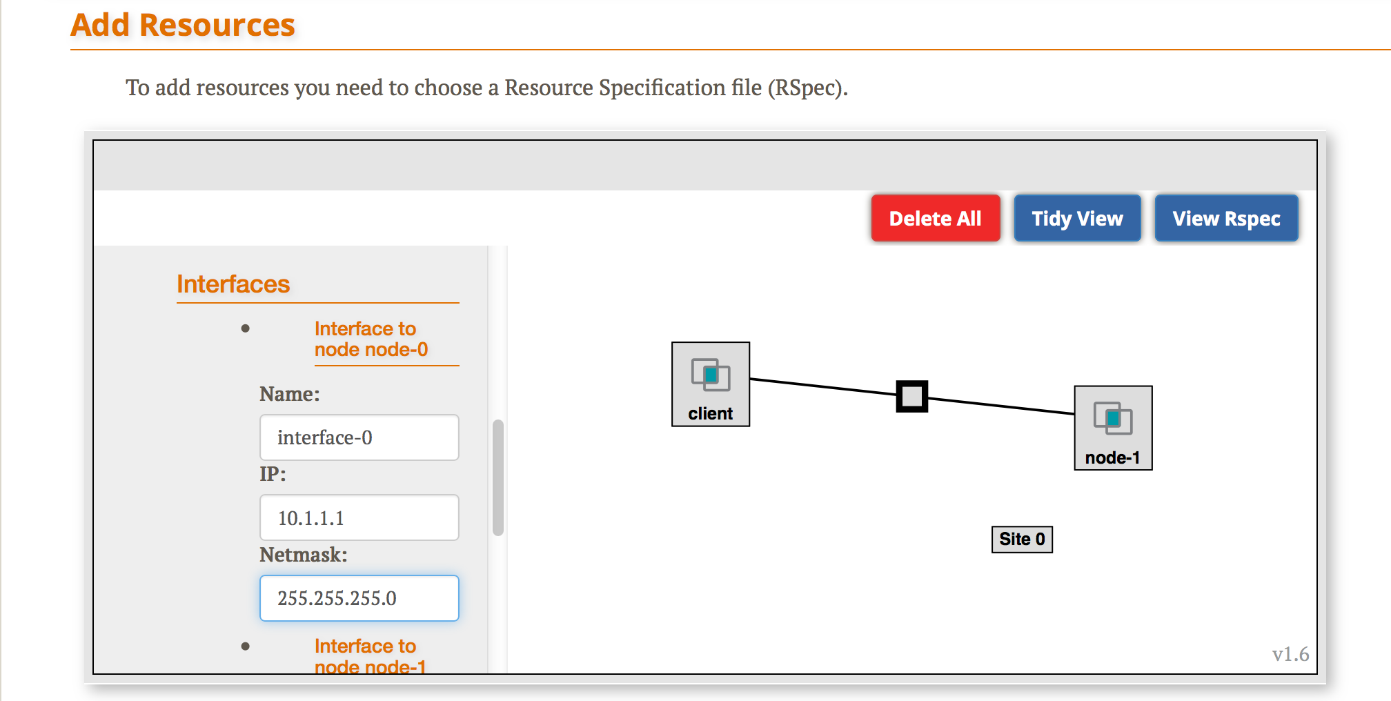
3.3
Set IP and mask of interfaces
Notes:
Now change the name of the VMs by clicking on the “i” in a circle and editing the name in the pop up.
Make one VM “client” and the other “server”.

Slide 43
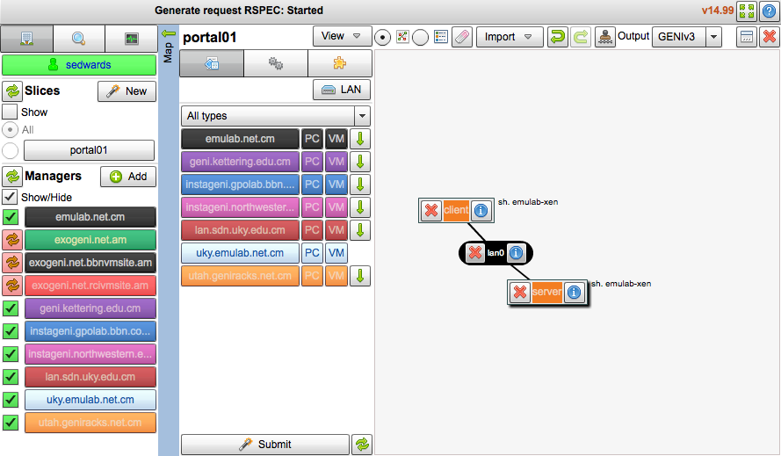
3.3
Reserve resources
Notes:
When your topology looks like this, press the “Submit” button along the bottom.

Slide 44
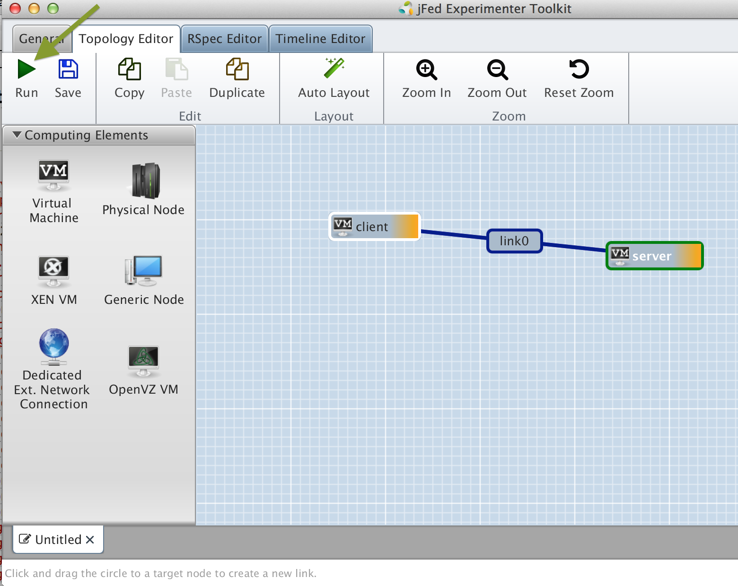
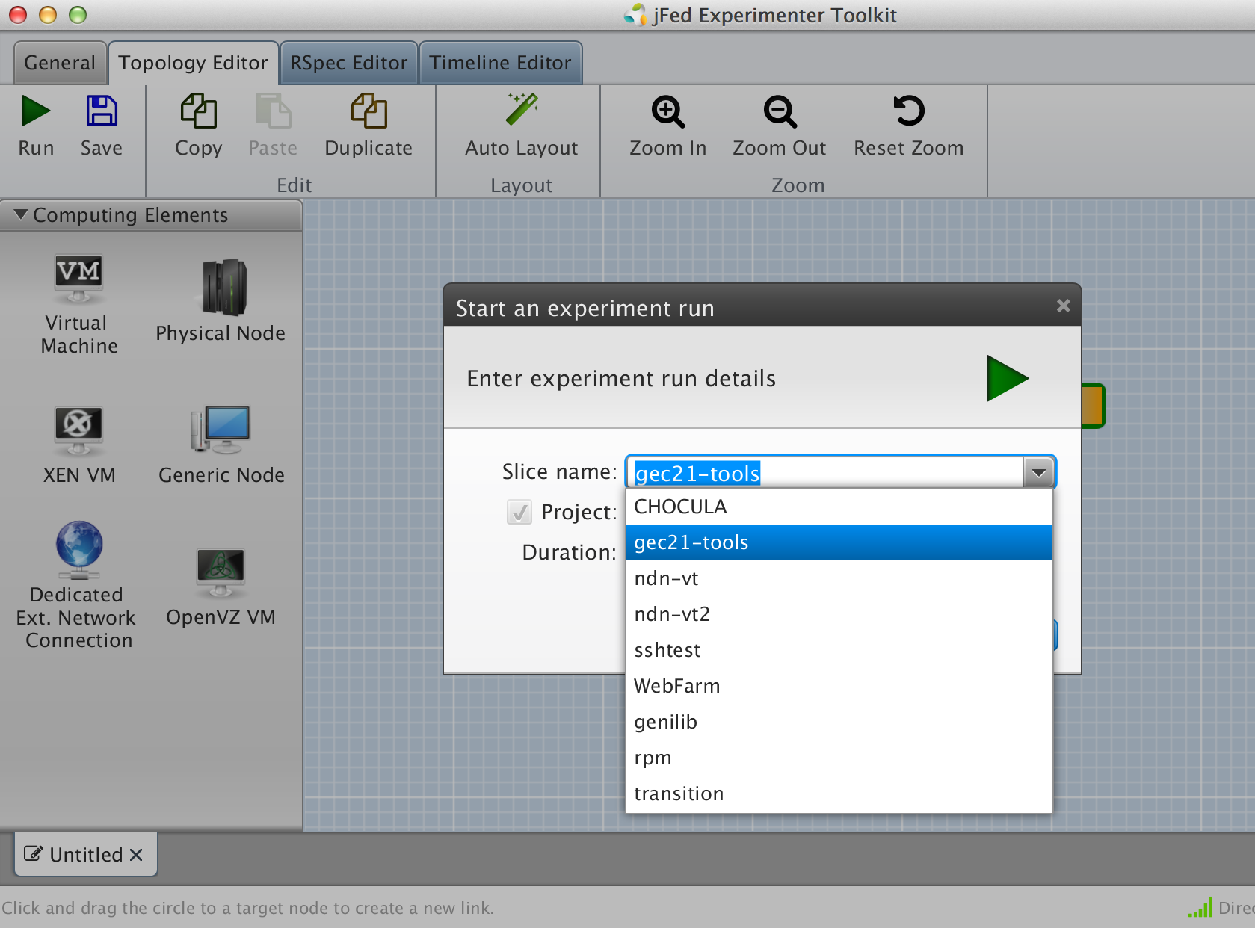
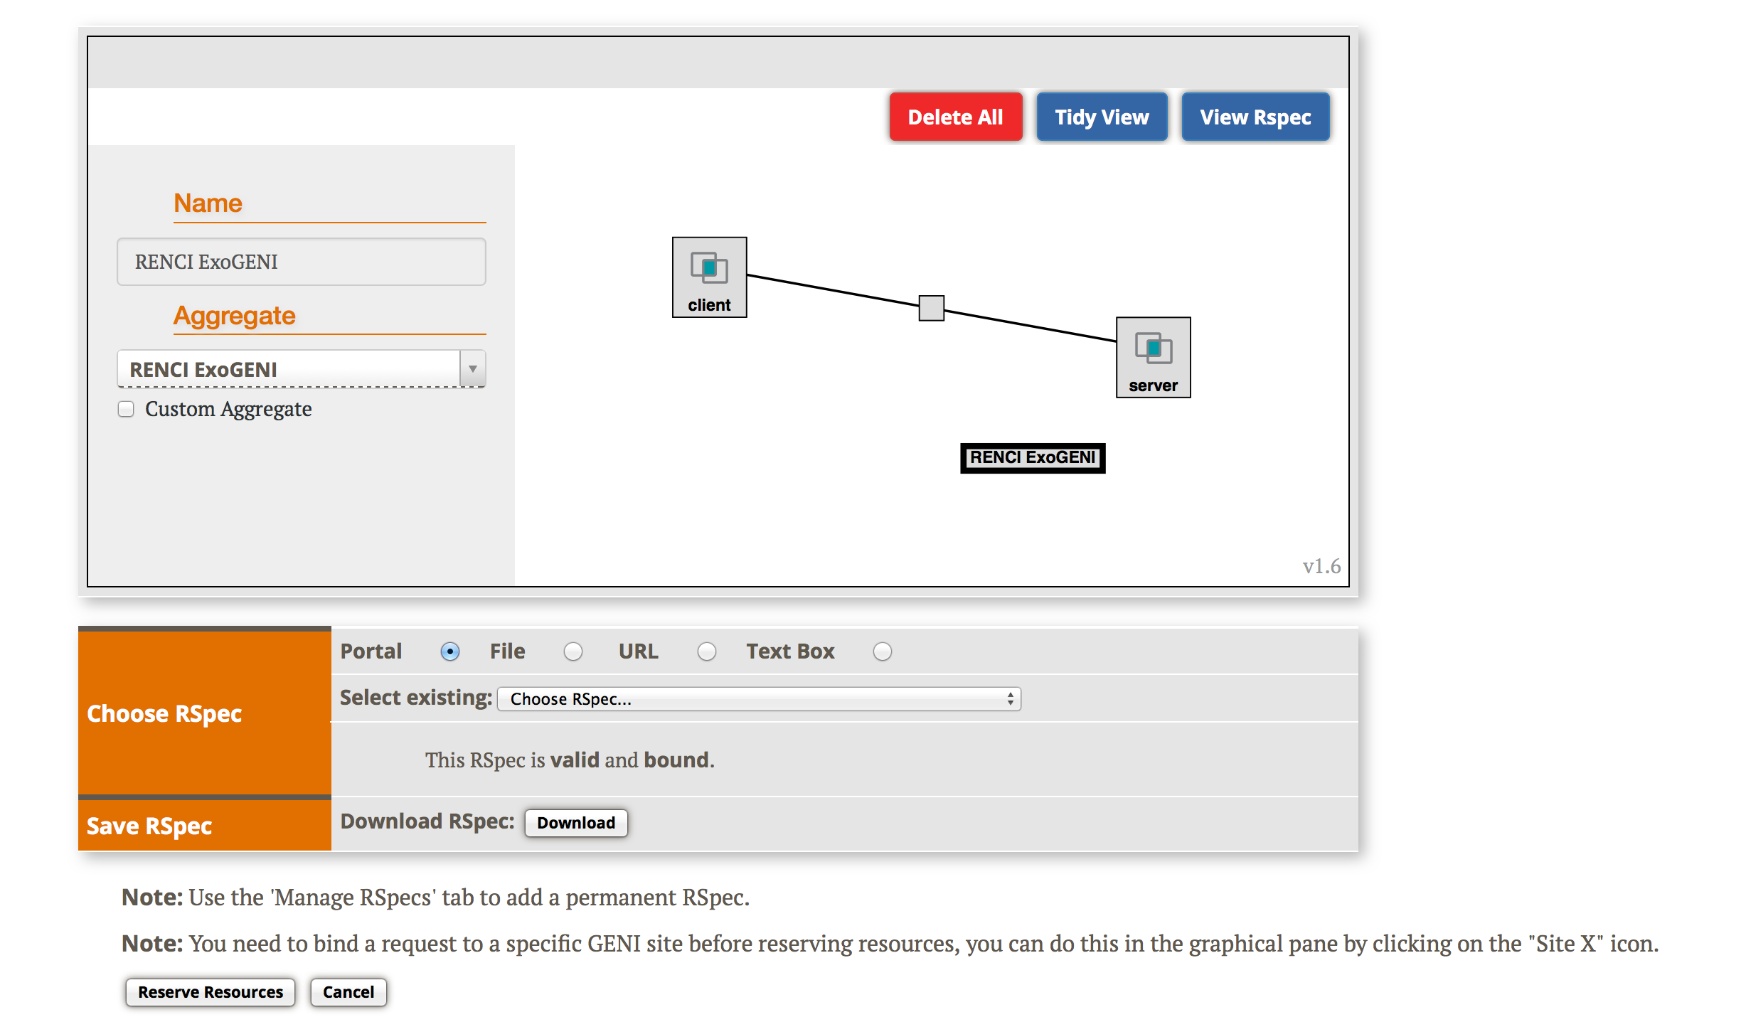
3.3
Reserve resources
Select a Slice
Bind to an Aggregate
Reserve resources
Notes:
When your topology looks like this, press the “Submit” button along the bottom.

Slide 45
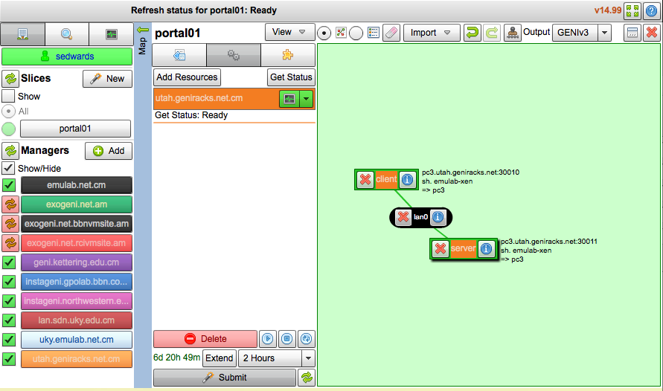
3.4
Resources are READY!!!
Notes:
After some time the background will turn green indicating that the resources are ready.

Slide 46
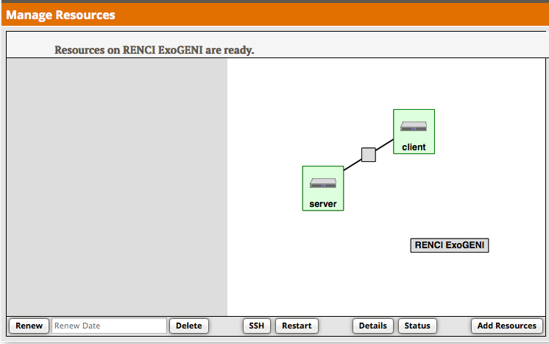
3.4
Resources are READY!!!
Notes:
After some time the background will turn green indicating that the resources are ready.

Slide 47
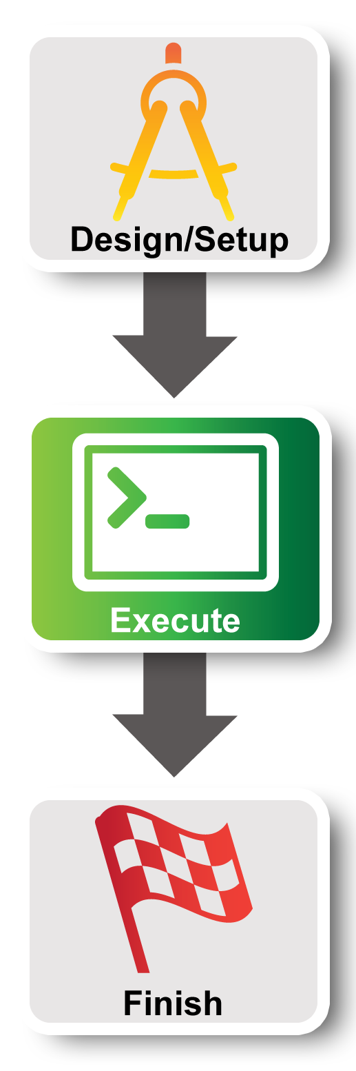
Experiment Workflow
Part I: Design/Setup
Part II: Execute
Part III: Finish
Notes:
In Part II we will execute the meat of the experiment….

Slide 48
Internet
Control plane switch
eth___
___.___.___.___
eth___
___.___.___.___
client
Data plane switch
server
Control i/f
Control i/f
Data i/f
eth___
Data i/f
eth___
10.1.1.1
10.1.1.2
GENI Rack

Slide 49
Part II:
Execute Experiment
Experimenter
Internet
ssh
Control Interfaces
client
Layer 2
server
Data Interfaces
4.1 Login to nodes (two nodes: client & server)
5 Execute experiment
5.1 Send IP traffic
5.2 Install and use iperf
5.3 Bring down the server’s data interface
5.4 Bring down the server’s control interface
6.1 Logout of nodes
Notes:
We have two nodes (“client” and “server”) and they each have two interfaces. The control interface connects to the public internet and is the interface you use to login to your nodes. The data interface is what we use for the experiment: it’s connected to the VLAN.
We will log into our nodes.
Then we will run our experiment ….
When we are done we’ll log out.

Slide 50
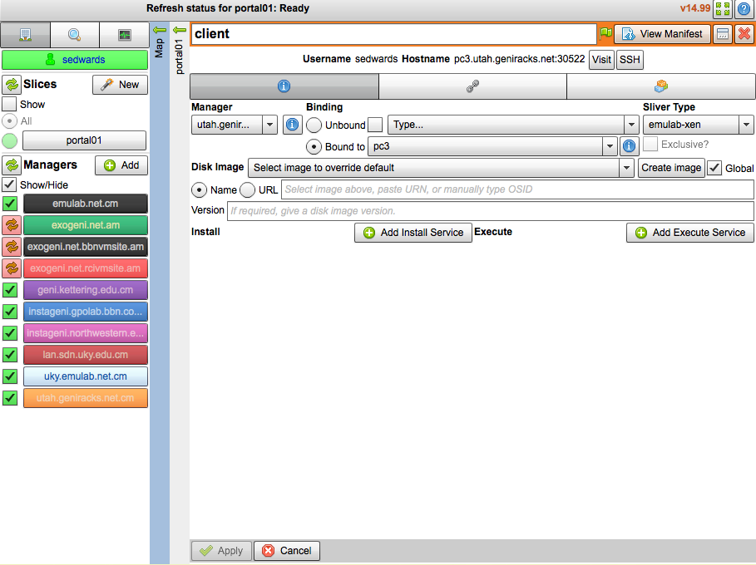
Login
4.1
Notes:
Click on the ssh command to login.
Those using ExoGENI, will need to click the “refresh” button (at the bottom near the Submit) button to get the ssh button to show up.

Slide 51
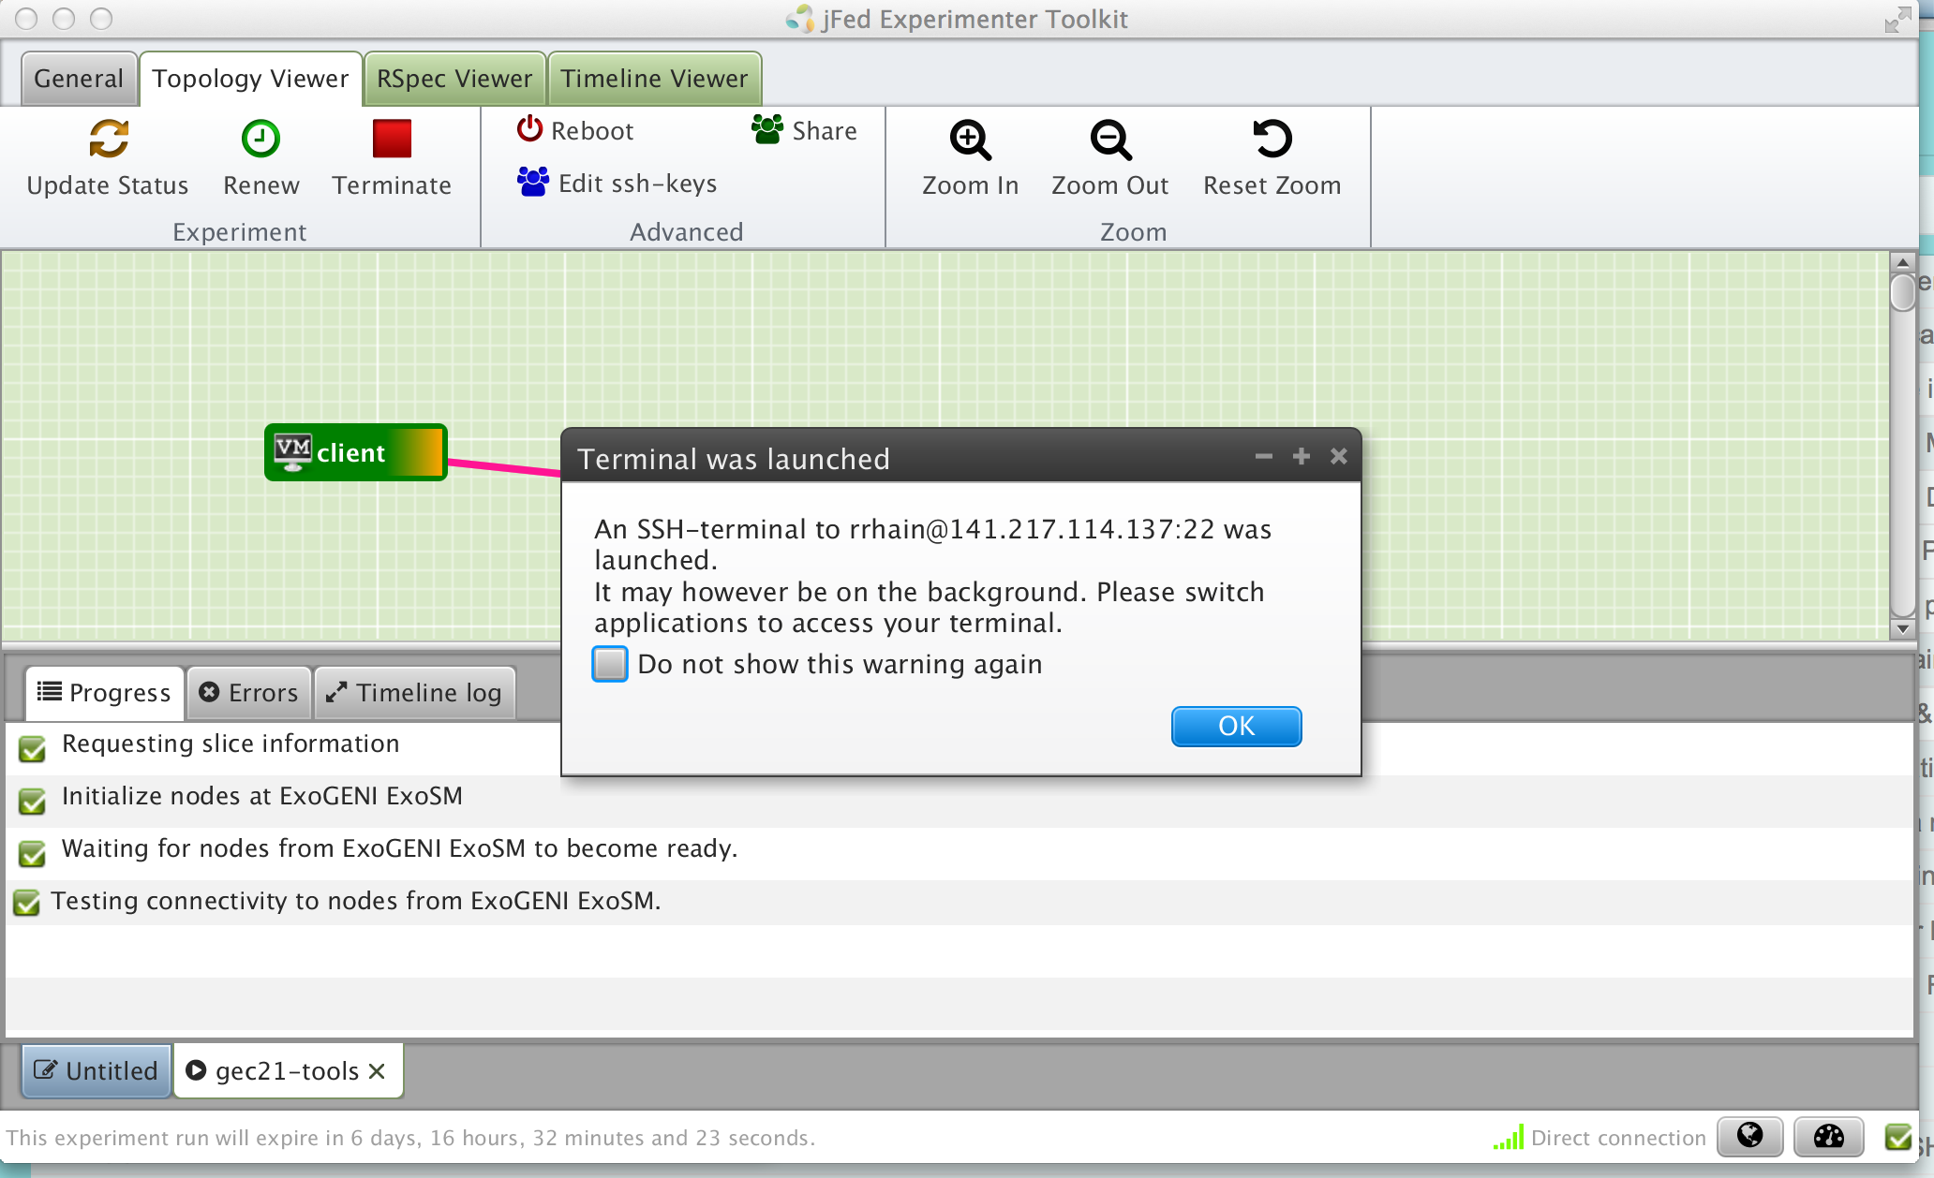
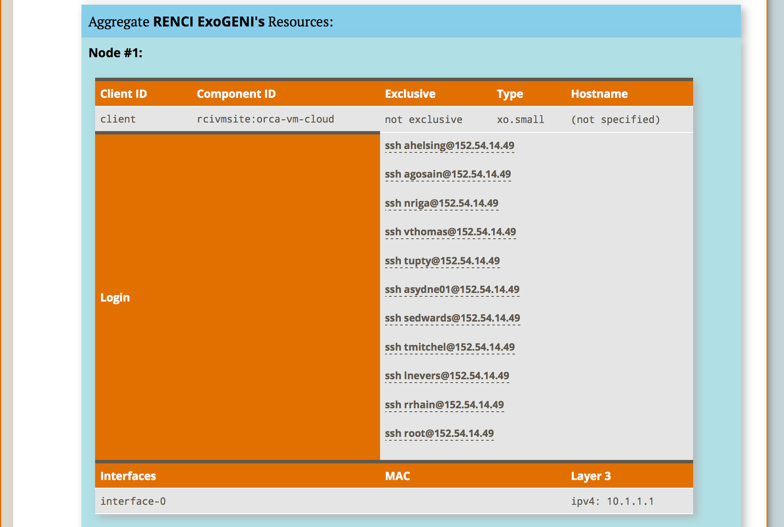
4.1
Login
Notes:
Click on the ssh command to login.
Those using ExoGENI, will need to click the “refresh” button (at the bottom near the Submit) button to get the ssh button to show up.

Slide 52
5.1
$ sudo ifconfig
$ ping 10.1.1.2 –c 5 # server data i/f
$ ping 172.17.1.9 –c 5 # server ctrl i/f
client
5.1
$ sudo ifconfig
server
Notes:
log into your two VMs
Next run ifconfig….
STOP and ….

Slide 53
Worksheet
5.1
Slice Name: lab0<your initials>
Internet
Control plane switch
eth___
___.___.___.___
eth___
___.___.___.___
client
Data plane switch
server
Control i/f
Control i/f
Data i/f
eth___
Data i/f
eth___
10.1.1.1
10.1.1.2
GENI Rack
Notes:
… fill in your worksheet. This is really important.
Be careful.
** Live portion **

Slide 54
$ sudo apt-get install iperf
$ hash
# server data i/f
$ iperf –c 10.1.1.2
…
# server ctrl i/f
$ iperf –c 172.17.2.4
…
5.2
$ sudo apt-get install iperf
$ hash
# start an iperf server
$ iperf -s
client
server
Notes:
Ping the server’s data interface. This should succeed. Let us know if this doesn’t work and we’ll help you debug it.
Ping the server’s control interface. This should also succeed.

Slide 55
What is the bandwidth of the data link? Why?
What is the bandwidth of the control link? Why?
5.2
Internet
Control plane switch
eth___
___.___.___.___
eth___
___.___.___.___
client
Data plane switch
server
Control i/f
Control i/f
Data i/f
eth___
Data i/f
eth___
10.1.1.1
10.1.1.2
GENI Rack
Notes:
What is the bandwidth of the data link? Why?
The bandwidth of the data link is about 100 Mbps which is the default.
What is the bandwidth of the control link? Why?
A lot more. Because you get the full available link.

Slide 56
Demo here
Notes:
When you bring down the data interface, the destination should become unreachable.
Why?
The client can no longer reach that interface on the server.
After you bring down the control interface, your ssh session should immediately hang.
Why?
You brought down the interface you were using to log into the node.
After you bring down the control interface, the destination should become unreachable.
Why?
The client can no longer reach that interface on the server.

Slide 57
# ping server data i/f
$ ping 10.1.1.2
…
# ping server ctrl i/f
$ ping 172.17.2.4
…
$ exit
5.3
# For ExoGENI only do:
$ sudo service neuca stop
# bring down data i/f
$ sudo ifconfig eth12541 down
# bring down ctrl i/f
$ sudo ifconfig eth999 down
5.4
client
server
Notes:
Ping the server’s data interface. This should succeed.
Next bring down the data interface on the server node.
Your pings should start to fail.
Ping the server’s control interface. This should succeed.
Next bring down the control interface on the server node.
Your ssh connection to the server node should immediately hang.
And your pings should start to fail.

Slide 58
Demo here
Notes:
When you bring down the data interface, the destination should become unreachable.
Why?
The client can no longer reach that interface on the server.
After you bring down the control interface, your ssh session should immediately hang.
Why?
You brought down the interface you were using to log into the node.
After you bring down the control interface, the destination should become unreachable.
Why?
The client can no longer reach that interface on the server.

Slide 59
5.4
When you bring down the data interface, the destination should become unreachable. Why?
Internet
Control plane switch
eth___
___.___.___.___
eth___
___.___.___.___
client
Data plane switch
server
Control i/f
Control i/f
Data i/f
eth___
Data i/f
eth___
10.1.1.1
10.1.1.2
GENI Rack
Notes:
When you bring down the data interface, the destination should become unreachable.
Why?
The client can no longer reach that interface on the server.
After you bring down the control interface, your ssh session should immediately hang.
Why?
You brought down the interface you were using to log into the node.
After you bring down the control interface, the destination should become unreachable.
Why?
The client can no longer reach that interface on the server.

Slide 60
5.4
After you bring down the control interface, the destination becomes unreachable. Why?
Internet
Control plane switch
eth___
___.___.___.___
eth___
___.___.___.___
client
Data plane switch
server
Control i/f
Control i/f
Data i/f
eth___
Data i/f
eth___
10.1.1.1
10.1.1.2
GENI Rack
Notes:
When you bring down the data interface, the destination should become unreachable.
Why?
The client can no longer reach that interface on the server.
After you bring down the control interface, your ssh session should immediately hang.
Why?
You brought down the interface you were using to log into the node.
After you bring down the control interface, the destination should become unreachable.
Why?
The client can no longer reach that interface on the server.

Slide 61
5.4
After you bring down the control interface, your ssh session should immediately hang. Why?
Internet
Control plane switch
eth___
___.___.___.___
eth___
___.___.___.___
client
Data plane switch
server
Control i/f
Control i/f
Data i/f
eth___
Data i/f
eth___
10.1.1.1
10.1.1.2
GENI Rack
Notes:
When you bring down the data interface, the destination should become unreachable.
Why?
The client can no longer reach that interface on the server.
After you bring down the control interface, your ssh session should immediately hang.
Why?
You brought down the interface you were using to log into the node.
After you bring down the control interface, the destination should become unreachable.
Why?
The client can no longer reach that interface on the server.

Slide 62
You are trying to log in to a compute node on GENI using SSH and can’t.
Which are possible explanations?
You entered the wrong password
You didn’t offer the private key that matches the public key
The public key wasn’t loaded onto the node
Permissions on the private key are too permissive
(b), (c), and (d)
Notes:
After some time the background will turn green indicating that the resources are ready.

Slide 63
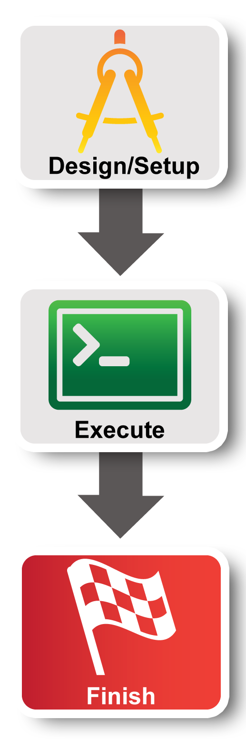
Experiment Workflow
Part I: Design/Setup
Part II: Execute
Part III: Finish
Notes:
The third part of the experiment is when you would normally archive any data and release your resources.

Slide 64
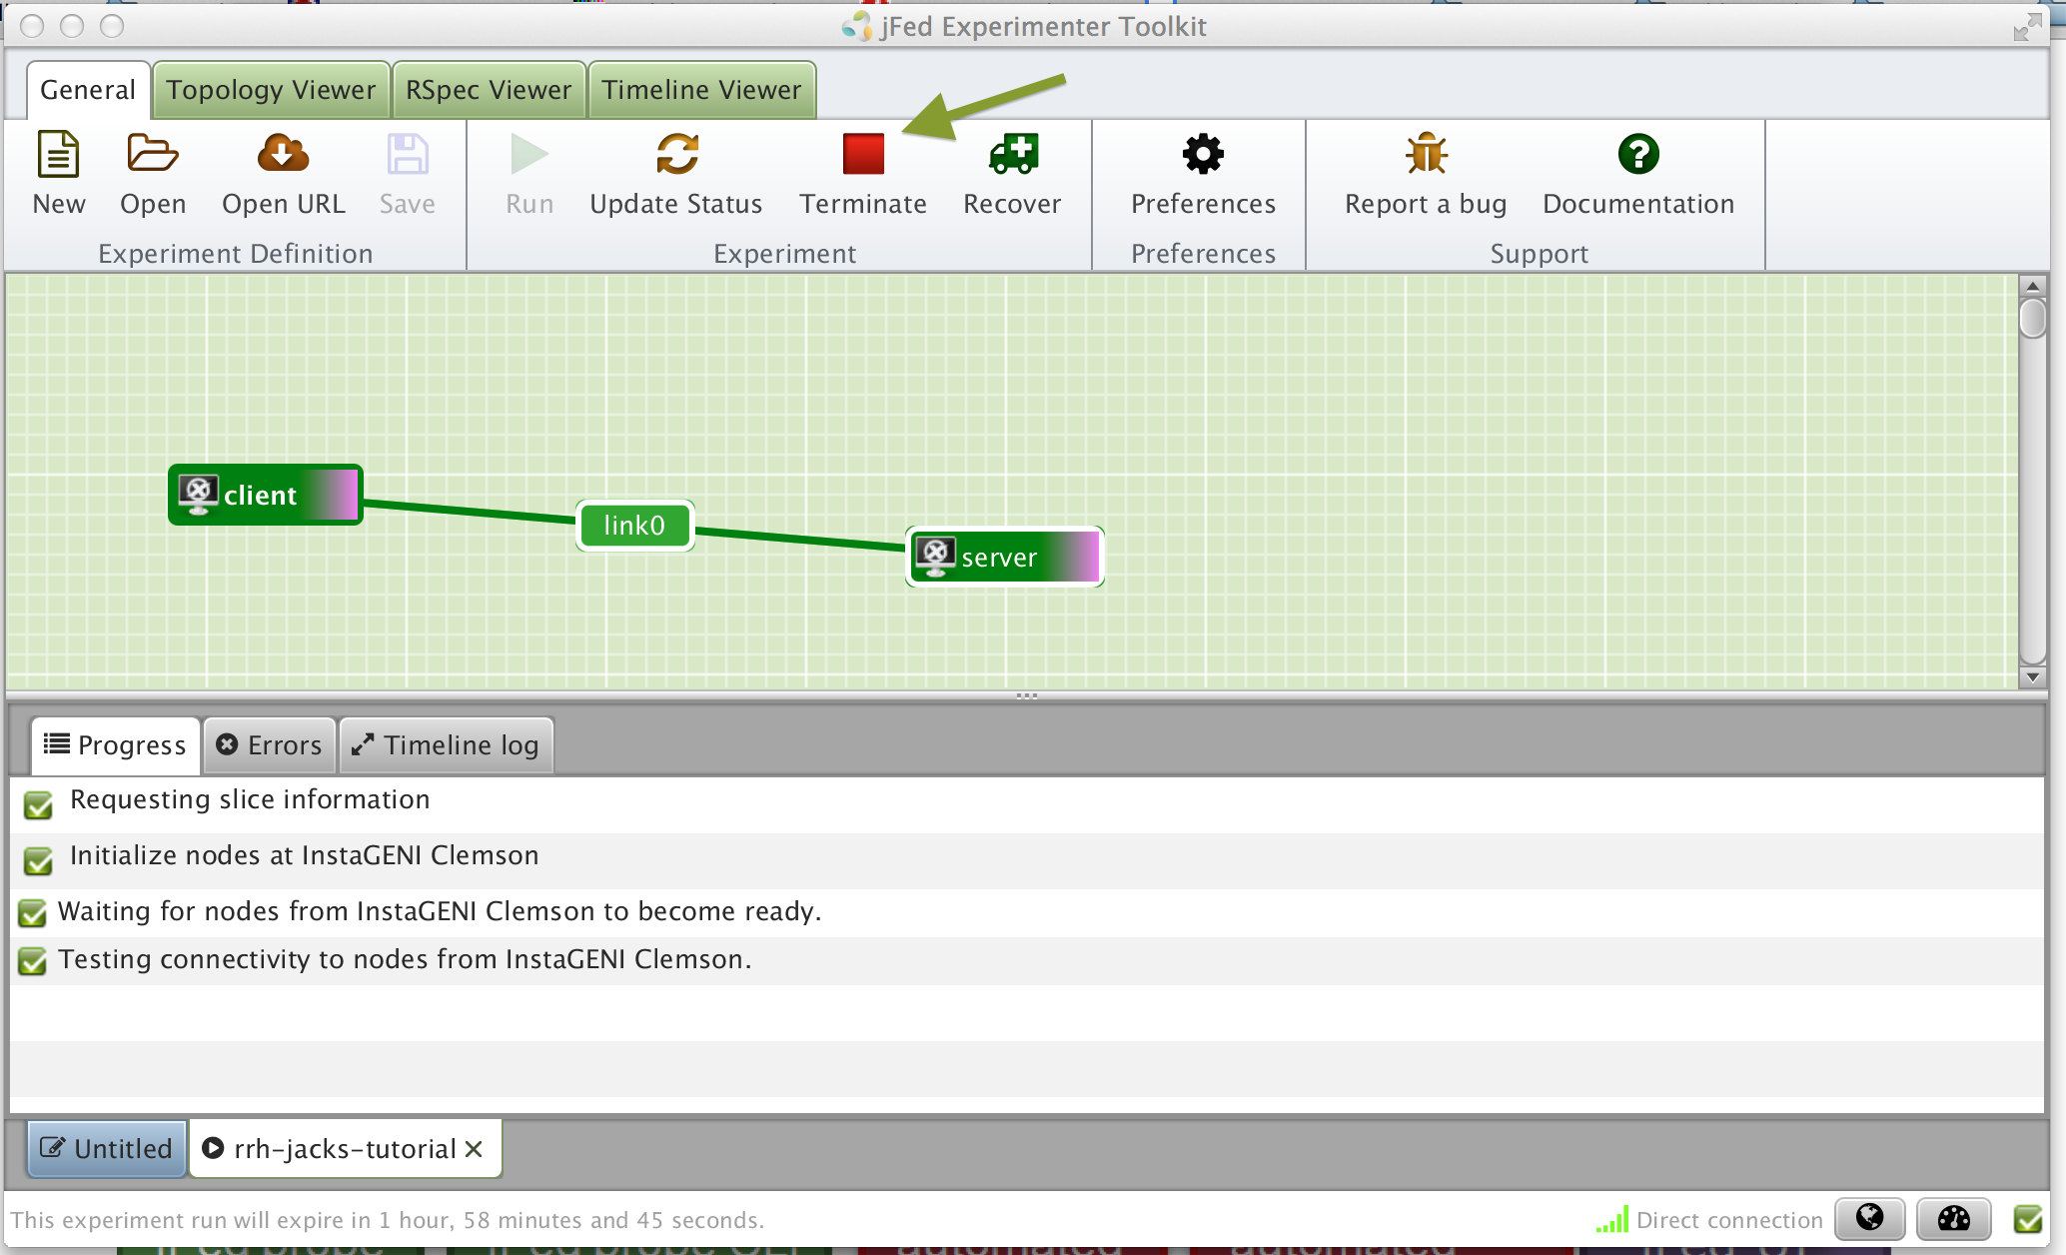
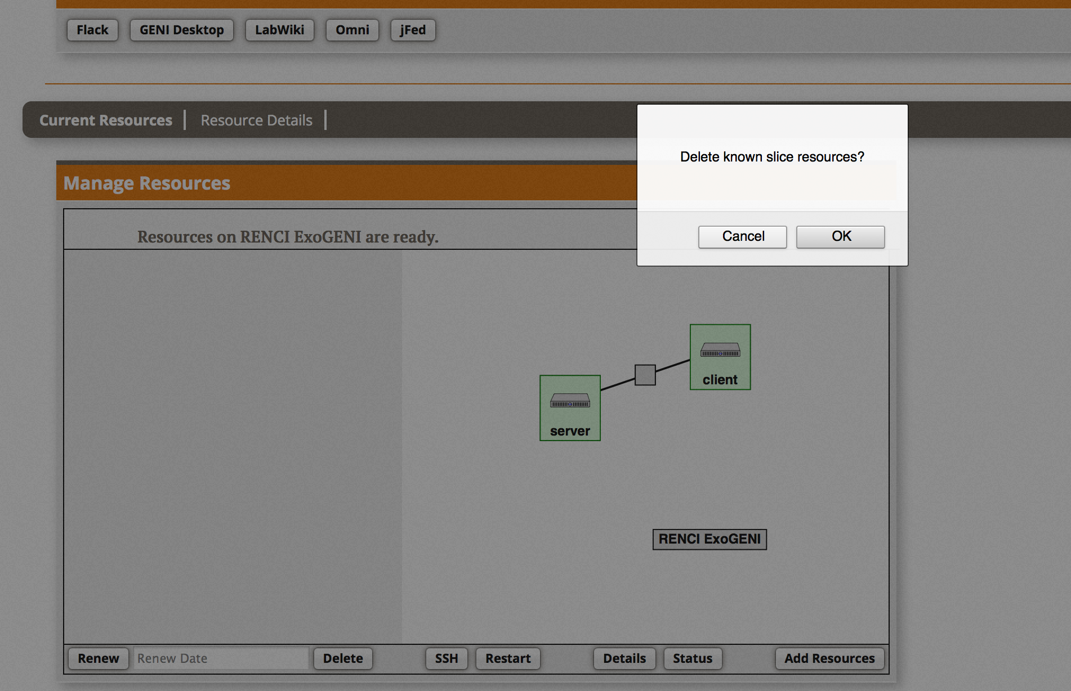
7
Delete Resources
Notes:
The delete button is on the bottom of Flack (above the Submit button).

Slide 65

Part III:
Finish Experiment
project
resource
experimenter
aggregate
slice
When your experiment is done, you should always release your resources.
  Normally this is when you would archive your data
  Delete your resources at each aggregate
Notes:
Be sure to delete your resources.

Slide 66
Congratulations!
You have…
  Run your first GENI Experiment!
  Exercised your knowledge of GENI terminology
  Used the GENI Portal and Flack
Notes:
When we started, we promised to do three things.
You’ve run your first GENI experiment.
You’ve hopefully developed a more concrete understanding of GENI terminology.
You have used the GENI portal and Flack

Slide 67
Welcome
to GENI!

Slide 68
Working With Collaborators

Slide 69
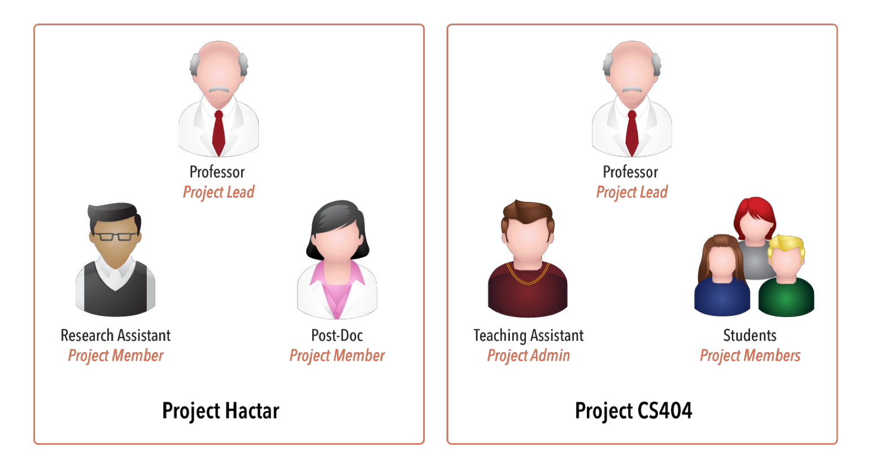

Project Membership example
Projects have 1 Lead and any number of Admins, Members, and Auditors
Expiration
Typical Research Project
Typical Class
http://groups.geni.net/geni/wiki/GENIConcepts#Project
Notes:
Calendar clipart: http://all-free-download.com/free-vector/vector-clip-art/table_calendar_clip_art_12117.html
Projects have an optional expiration (e.g. for classes, tutorials)
For classes it is recommended to have the project expire at the end of the class.

Slide 70
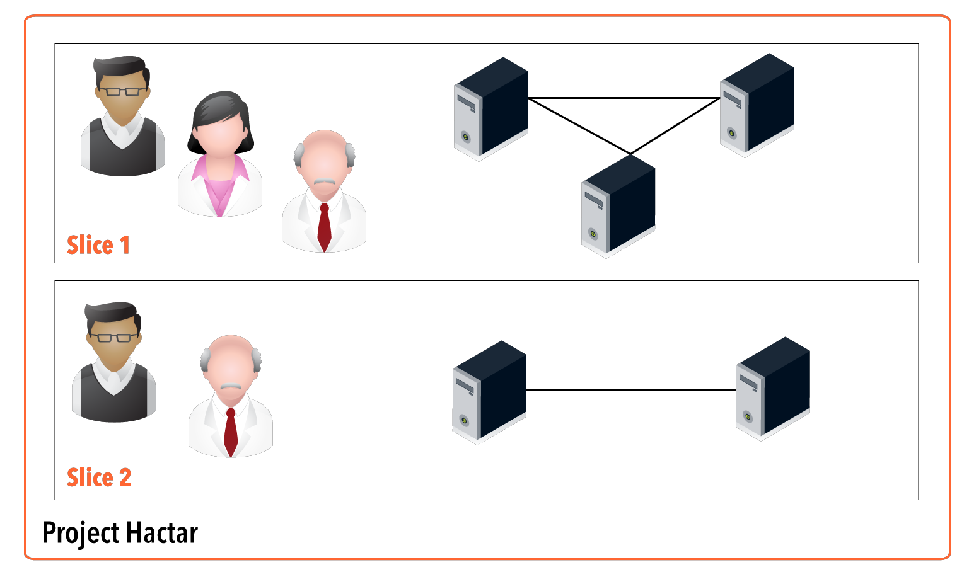
Working with multiple members in a slice
Members of all slices in a project:
Project Leads (Professor)
Project Admins (Post-docs, researchers)
Other can be added manually
Research Asst
Slice Lead
Post-Doc
Slice Member
Professor
Slice Admin
http://groups.geni.net/geni/wiki/GENIConcepts#Slice

Slide 71
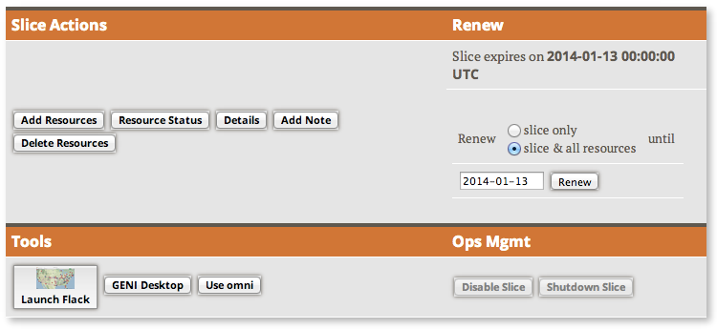
Slice Access
Being a member of a slice means you can act on a slice:
  Add resources
  Check status
  Delete resources
  Renew resources
With any tool!

Slide 72

Slice Access: Logging in to resources
To ensure access in collaborator’s resources:
  Option 1: Make resource reservation from Portal or omni
  Option 2: Use a common public key
Add slice member’s accounts to existing resources:
$ omni -V 3 poa SLICE geni_update_users
--useSliceAggregates –-useSliceMembers
Alternatively…
$ addMemberToSliceAndSlivers myslice username
Slice membership does not guarantee ability to login to resources!
Only works on InstaGENI/ProtoGENI
Notes:
Add options

Slide 73
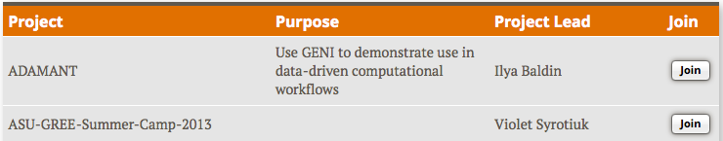
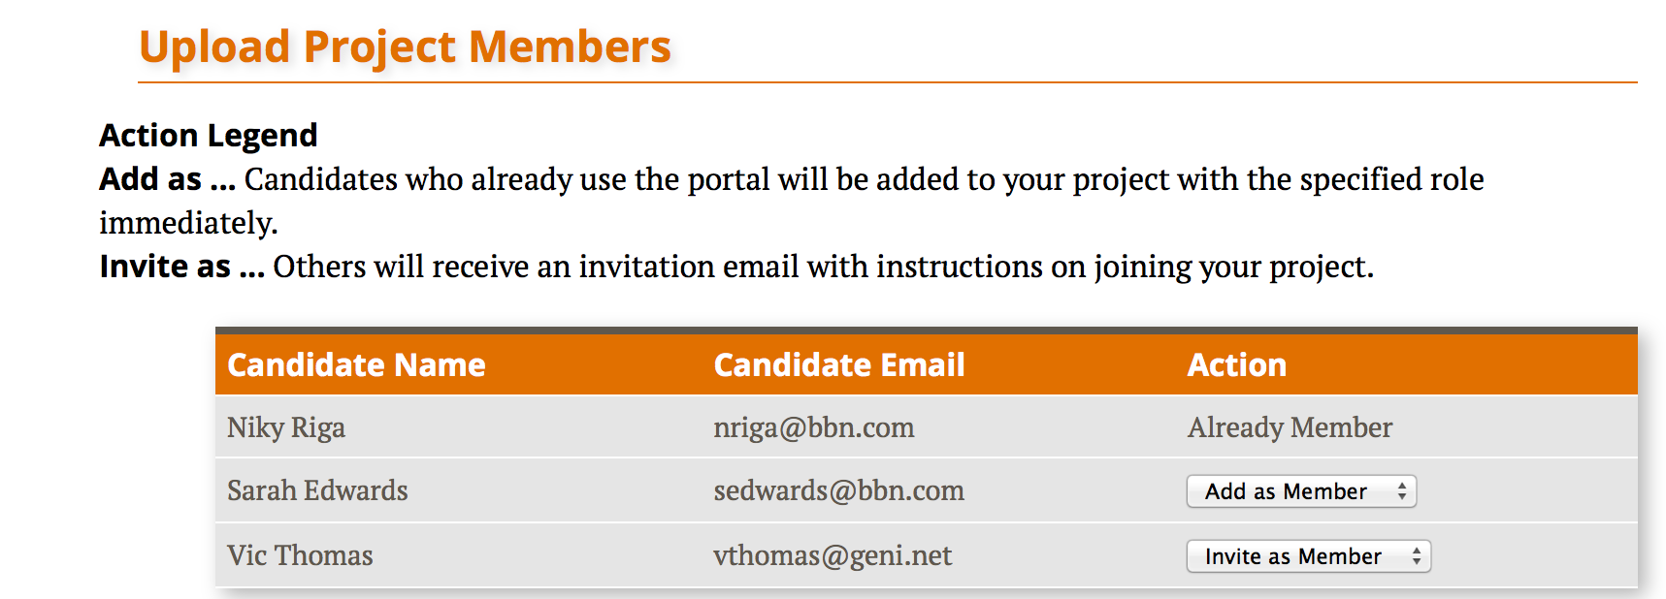
Populating a Project
Member-initiated
  Each experimenter asks to join a project, approval needed
    Typical for Research projects
Admin-initiated
  Project Lead/Admin bulk-adds experimenters
    Typical for Classrooms or Tutorials

Slide 74
Project and Slice Roles
 |  | Create project | Modify project & manage membership | Create slice | View project
Project | Lead | ✔ | ✔ | ✔ | ✔
 | Admin |  | ✔ | ✔ | ✔
 | Member |  |  | ✔ | ✔
 | Auditor |  |  |  | ✔
 |  | Manage slice membership | Act on slice | View slice | Account/ keys loaded on slice
Slice | Lead | ✔ | ✔ | ✔ | ✔
 | Admin | ✔ | ✔ | ✔ | ✔
 | Member |  | ✔ | ✔ | ✔
 | Auditor |  |  | ✔ | ✔
http://groups.geni.net/geni/wiki/ProjectSlicesRoles
Notes:
Project role definitions: http://groups.geni.net/geni/wiki/GENIGlossary#Project
Slice role definitions: http://groups.geni.net/geni/wiki/GENIGlossary#Slice

