Slide 1





GENI
Exploring Networks of the Future
GENI Project Office
www.geni.net

Slide 2
Outline
What is GENI?
How is GENI being used?
Key GENI Concepts
Demo: A simple experiment using GENI

Slide 3
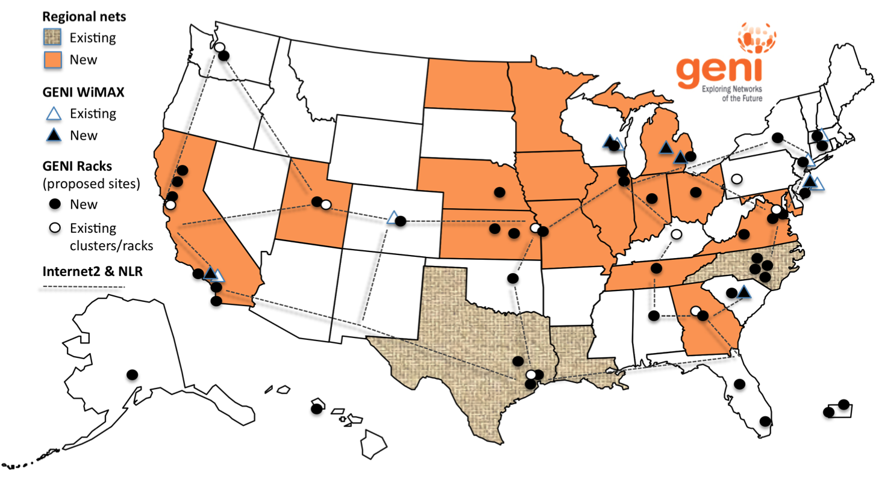
GENI: Infrastructure for Experimentation
GENI provides compute resources that can be connected in experimenter specified Layer 2 topologies.
Notes:
GENI is a nationwide suite of infrastructure for
“at scale” experiments in networking, distributed systems, security, and novel applications.
GENI opens up huge new opportunities
Leading-edge research in next-generation internets
Rapid innovation in novel, large-scale applications
Key GENI concept: slices & deep programmability
Internet: open innovation in application programs
GENI: open innovation deep into the network

Slide 4
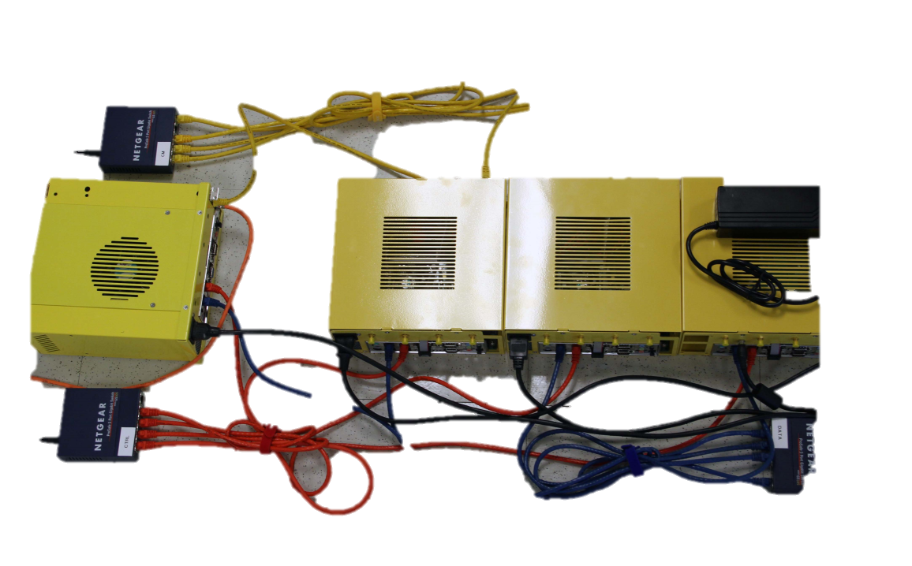
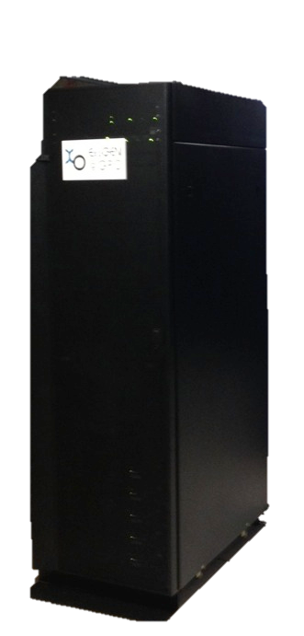
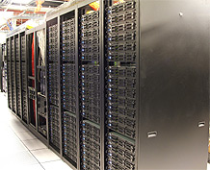
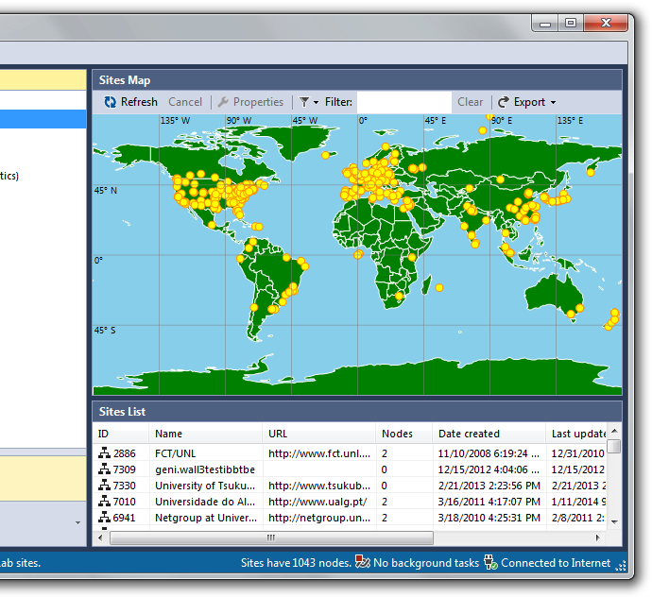
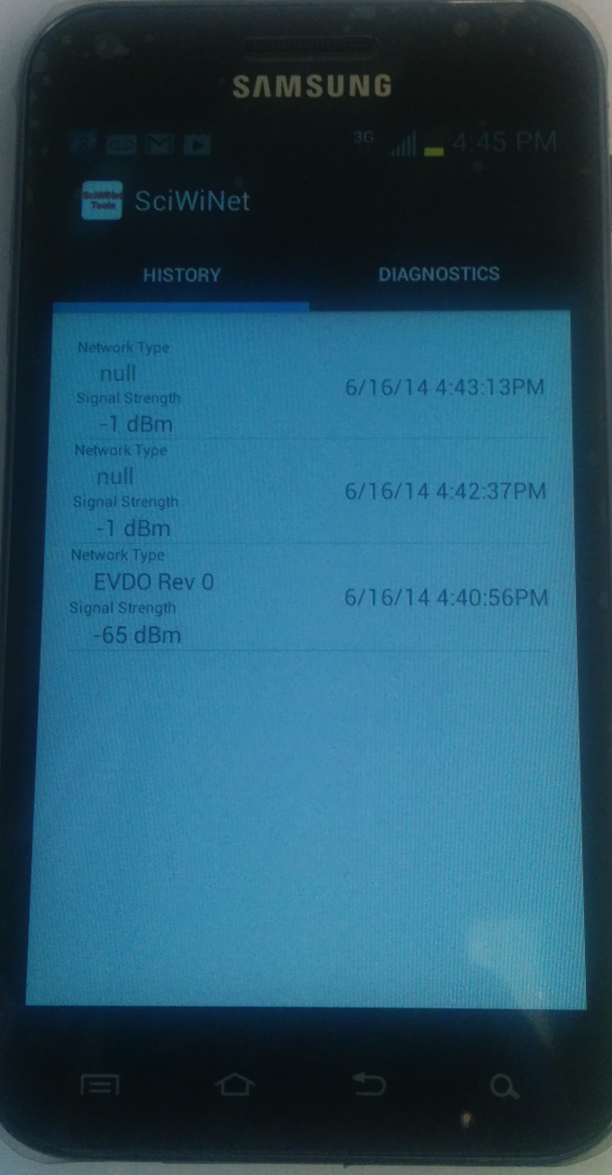
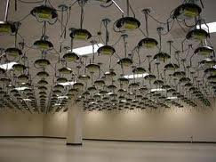
GENI Compute Resources
GENI Racks
GENI Wireless compute nodes
Emulab
Planetlab
ORBIT
Existing Testbeds

Slide 5
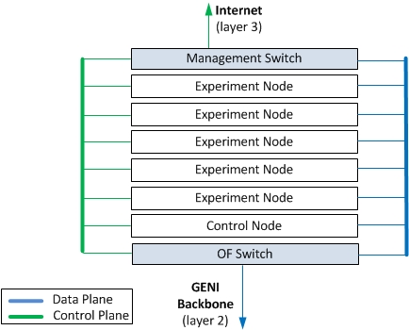
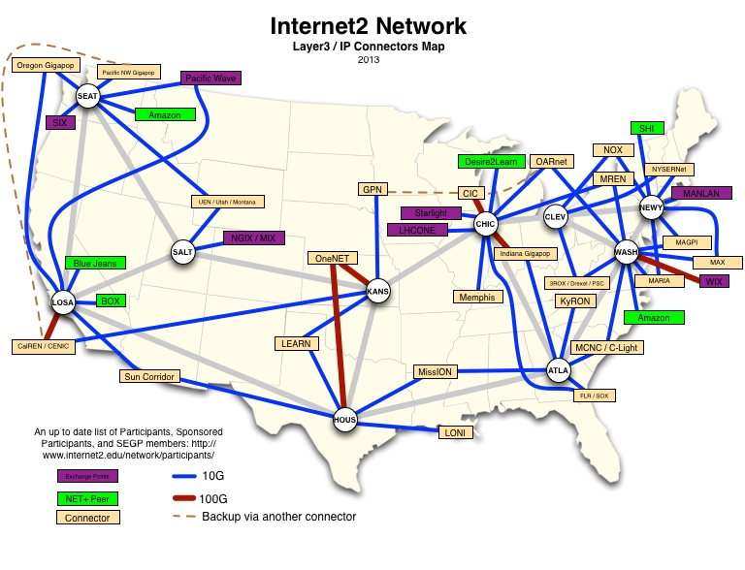
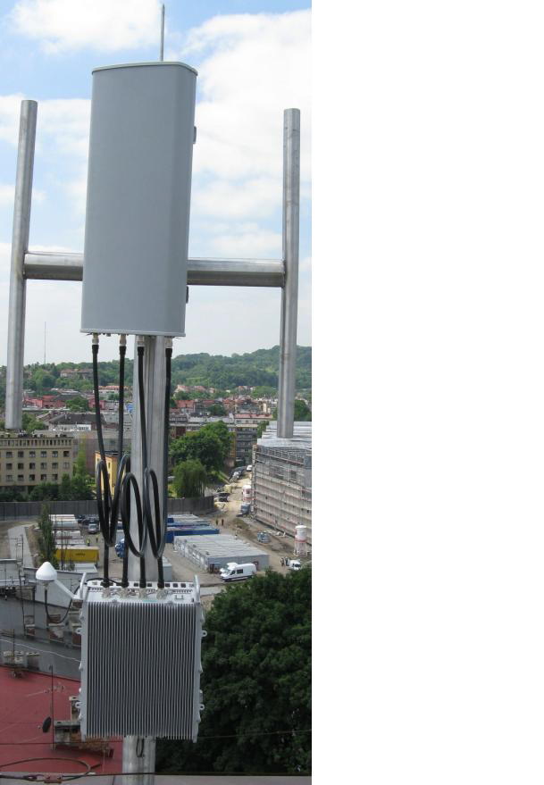
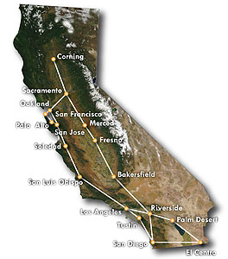
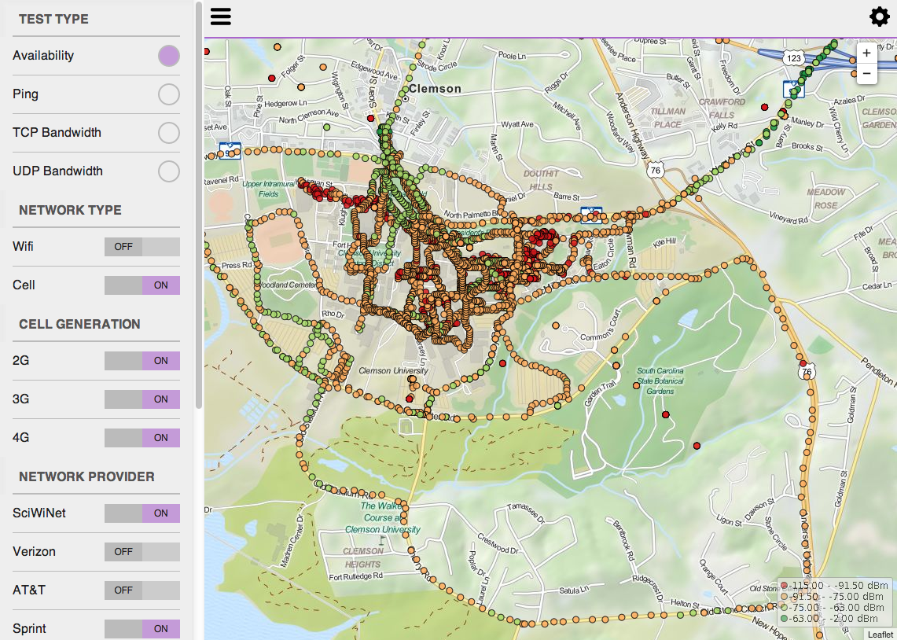
GENI Networking Resources
National Research Backbones
(e.g. Internet2)
Networking within a Rack
Regional Networks
(e.g. CENIC)
4G/3G
GENI network
WiMAX Base Stations

Slide 6







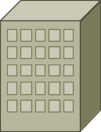













GENI Architecture
ISP
Internet
Metro
Research
Backbones
g
g
Layer 2
Data Plane
GENI-enabled
hardware
Legend
Layer 3
Control Plane
g
Regional Networks
Campus
Flexible network / cloud research infrastructure
Also suitable for physics, genomics, other domain science
Distributed cloud (racks) for content caching, acceleration, etc.

Slide 7
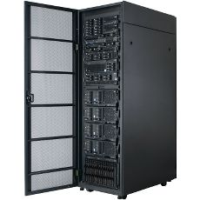
Current GENI buildout
More WiMAX base stations
with Android handsets
GENI-enable 5-6
regional networks
Inject more
OpenFlow switches
into Internet2
Add GENI Racks to 50-80 locations
within campuses, regionals, and
backbone networks
GENI Racks serve as programmable routers, distributed clouds, content distribution nodes, caching or transcoding nodes, etc

Slide 8
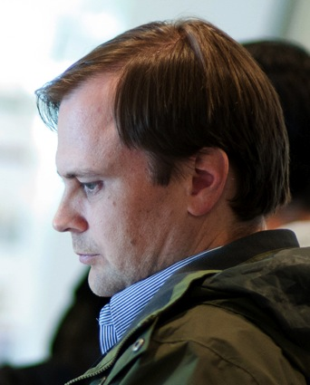






Creating and deploying GENI racks
Ilia Baldine
RENCI
More resources / rack,
fewer racks
Rajesh Narayanan
DELL
KC Wang Clemson
Rick McGeer
HP Labs
Fewer resources / rack,
more racks
Latest addition

Slide 9
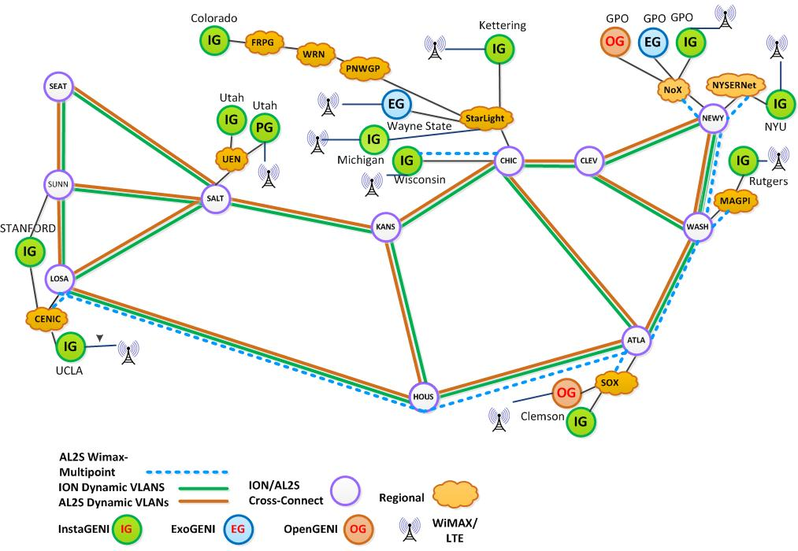
GENI WiMAX 2014
26 Wimax Base Stations in 13 Sites
90 android handsets available to experimenters
Sliced, virtualized
and interconnected through Internet2

Slide 10
GENI: Infrastructure for Experimentation
GENI provides compute resources that can be connected in experimenter specified Layer 2 topologies.
Notes:
GENI is a nationwide suite of infrastructure for
“at scale” experiments in networking, distributed systems, security, and novel applications.
GENI opens up huge new opportunities
Leading-edge research in next-generation internets
Rapid innovation in novel, large-scale applications
Key GENI concept: slices & deep programmability
Internet: open innovation in application programs
GENI: open innovation deep into the network

Slide 11


Multiple GENI Experiments run Concurrently
Resources in a slice may be virtualized
Experiments live in isolated slices

Slide 12

GENI is “Deeply Programmable”
I install software I want throughout my network slice (into routers, switches, …) or control switches using OpenFlow
OpenFlow part of the experiment not only the infrastructure
Notes:
Experimenters set up custom:
topologies
protocols
forwarding

Slide 13
Outline
What is GENI?
How is GENI being used?
Key GENI Concepts
Demo: A simple experiment using GENI

Slide 14

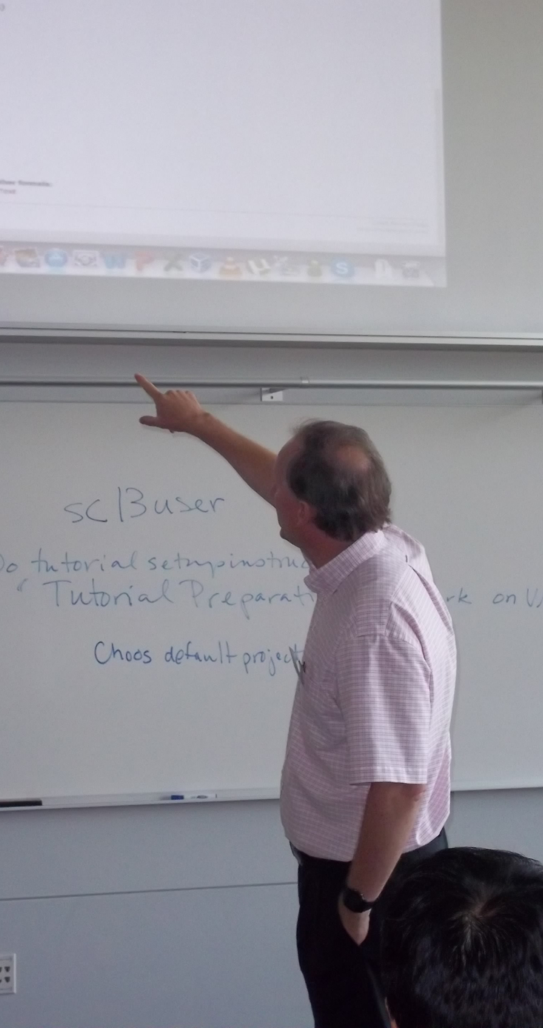
How is GENI being Used?
Research
Future Internet architectures
Software defined networking
Large scale evaluation of smart grid protocols
Education
Networking and Distributed systems classes
Cloud computing classes
WiMAX classes
As of October 2014, GENI has over 2700 users!

Slide 15
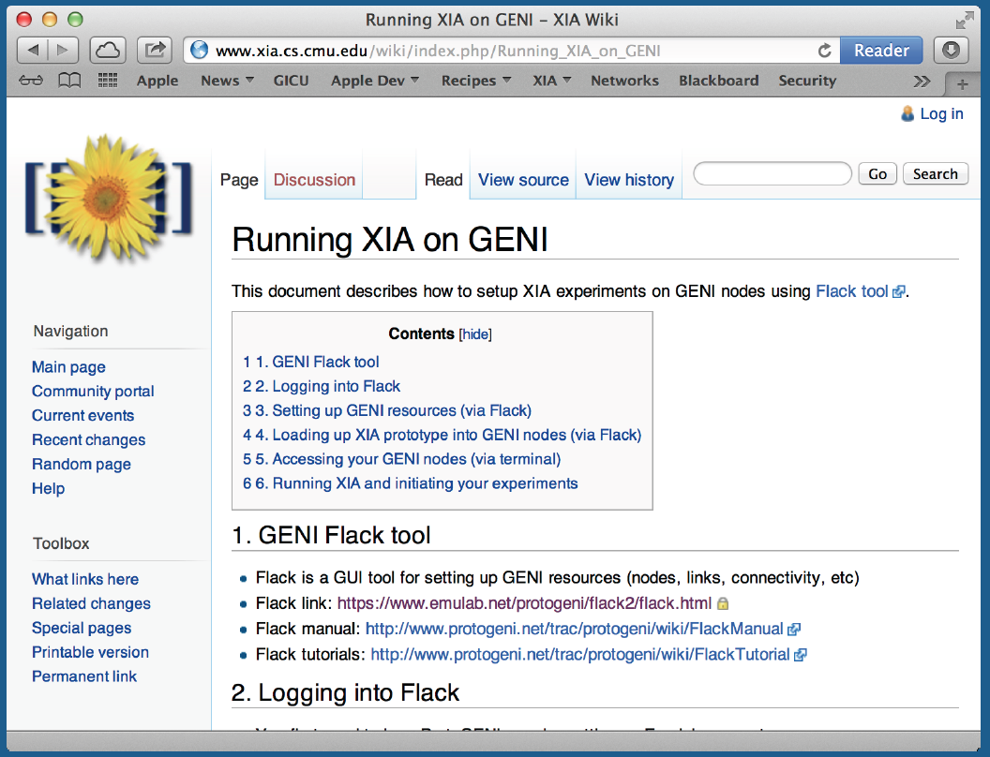
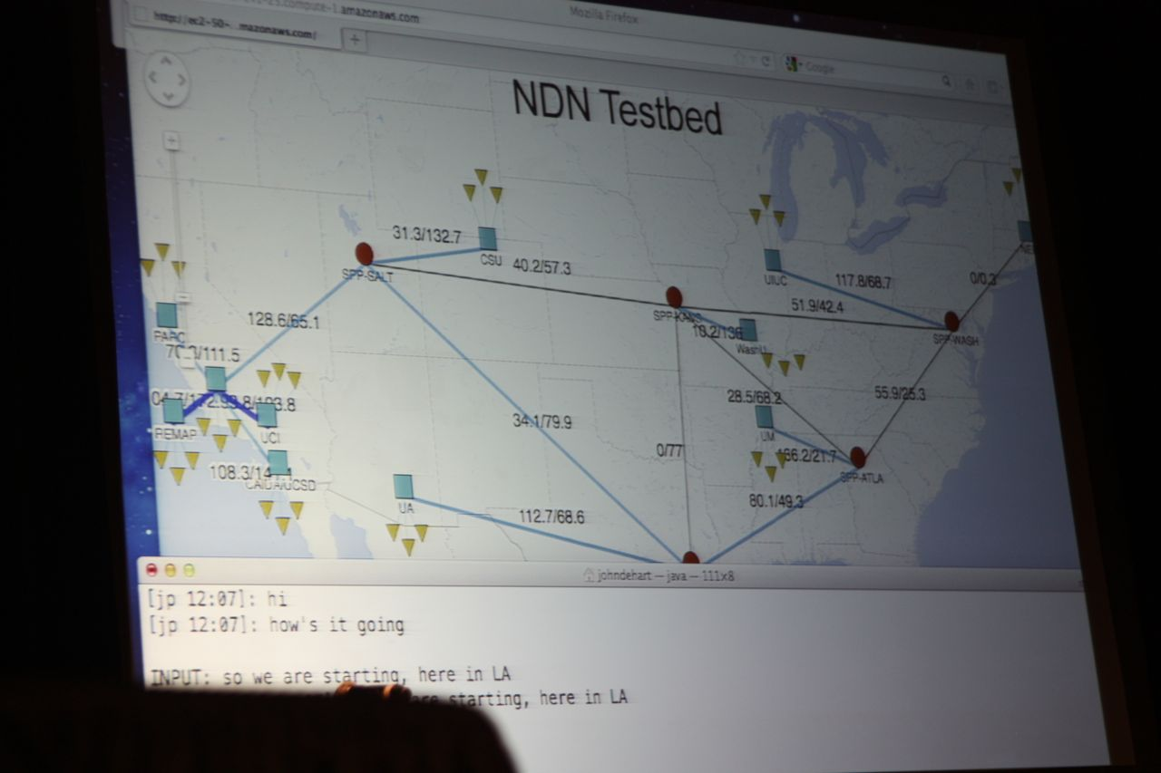
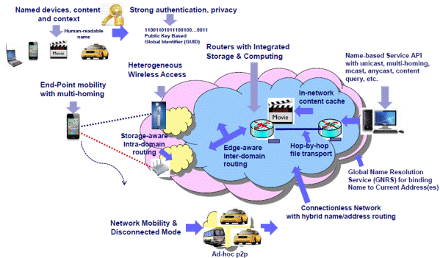
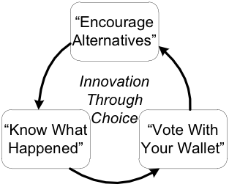
Four FIA Teams have Slices on GENI
NDN
XIA
MobilityFirst
ChoiceNet
GENI is the only testbed that can support these teams.

Slide 16
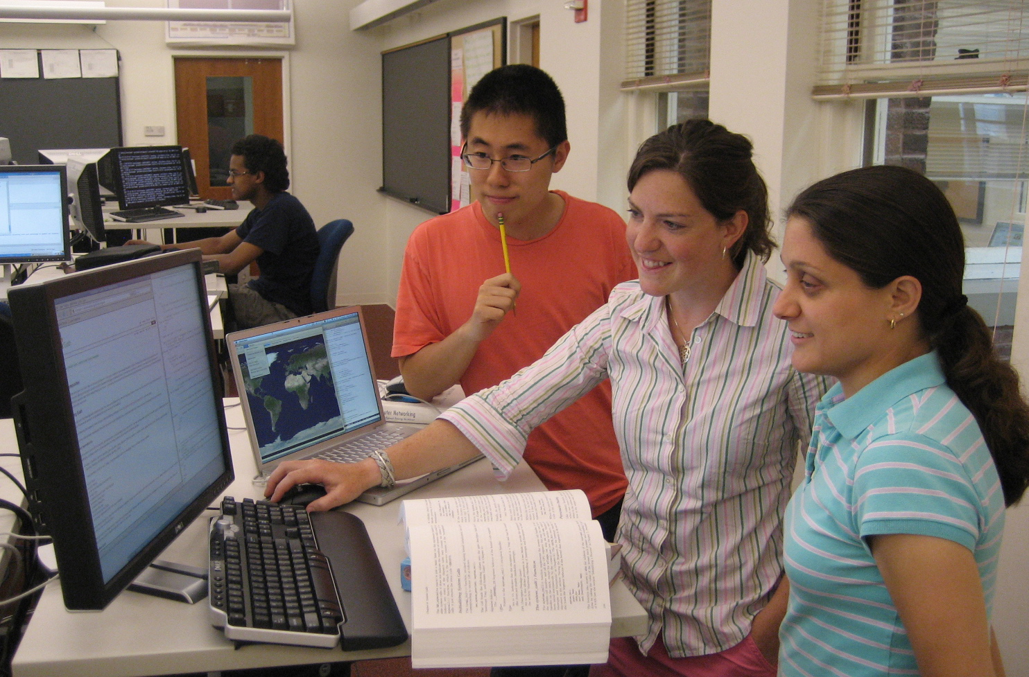
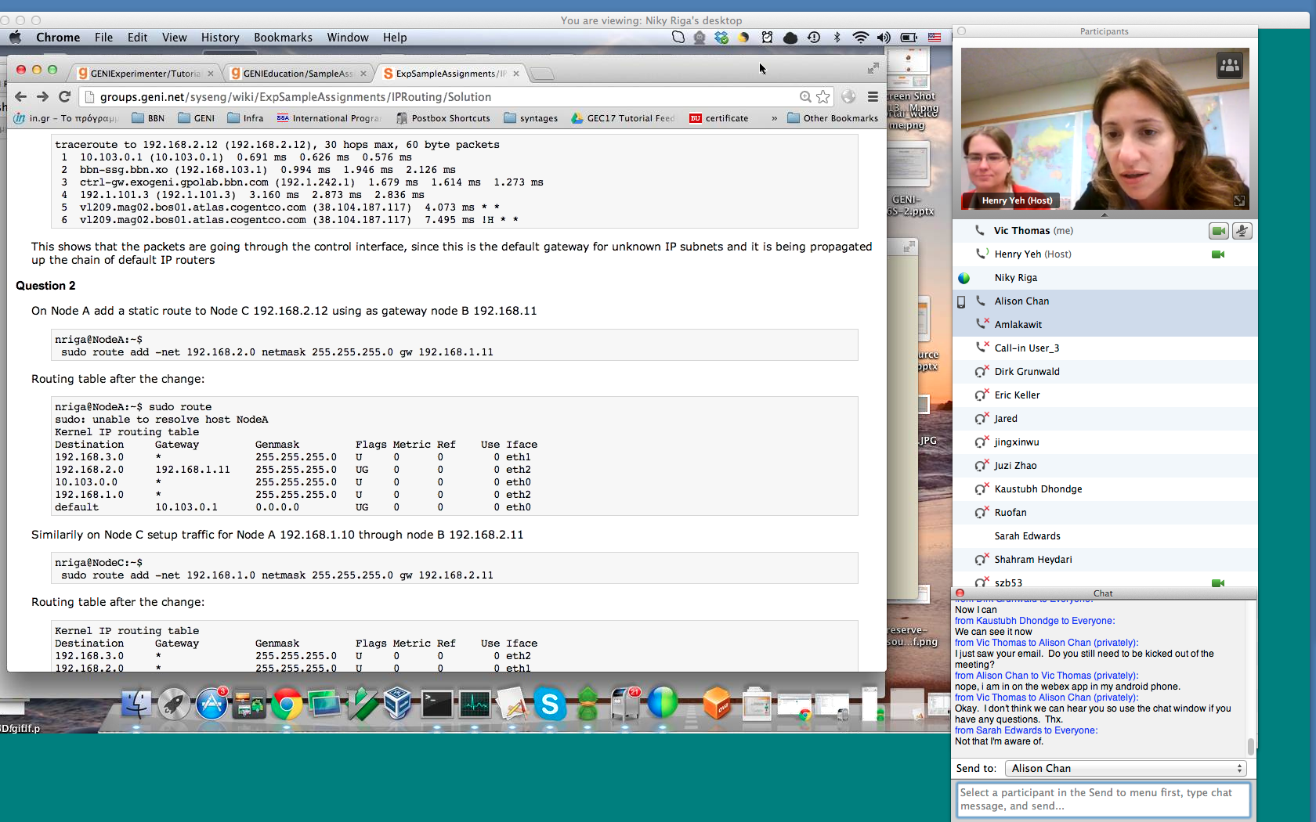
Growing use of GENI in the Classroom!
Over 50 classes have used GENI
Undergrad level
Graduate level
Used Internationally
Ready-to-use tutorials assignments
Teach how to use GENI
Teach networking concepts
Teach distributed computing concepts
Teach programmable networks
Train-the-TA tutorials
Start of each semester
Taught over WebEx
Jeannie Albrecht (Williams College) with students from her Spring 2012 Distributed Systems class
Train-the-TA Webinar

Slide 17
Outline
What is GENI?
How is GENI being used?
Key GENI Concepts
Demo: A simple experiment using GENI

Slide 18
GENI: Terms and Definitions
Slice
Abstraction for a collection of resources capable of running experiments
  An experiment uses resources in a slice
  Slices isolate experiments
  Experimenters are responsible for their slices

Slide 19
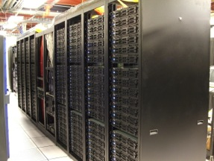
Clearinghouse and Aggregates
Create & Register Slice
users
projects
slices
Slice credentials
clearinghouse
Aggregate Manager API
- listResources
- createSliver
…
Researcher
Tool
Aggregate
Manager
Aggregate Resources
Clearinghouse: Manages users, projects and slices
  Standard credentials shared via custom API or new Common CH API
  GENI supported accounts: GENI Portal/CH, PlanetLab CH, ProtoGENI CH
Aggregate: Provides resources to GENI experimenters
  Typically owned and managed by an organization
  Speaks the GENI AM API
  Examples: PlanetLab, Emulab, GENI Racks on various campuses

Slide 20
GENI: Terms and Definitions
A sliver: One or more resources provided by an aggregate
  E.g. Bare machines, virtual machines, VLANs
GENI Rack
#3
My slice contains slivers from many aggregates.
Commercial
Clouds
Backbone #1
GENI Rack
#1
My GENI Slice
Access
#1
Corporate
GENI suites
Research
Testbed
Backbone #2
Other-Nation
Projects
GENI Rack
#2

Slide 21
Resource Specifications (RSpecs)
RSpecs: Lingua franca for describing and requesting resources
  “Machine language” for negotiating resources between experiment and aggregate
  Experimenter tools eliminate the need for most experimenters to write or read RSpec
<?xml version="1.0" encoding="UTF-8"?>
<rspec xmlns="http://www.protogeni.net/resources/rspec/2"
xmlns:xsi="http://www.w3.org/2001/XMLSchema-instance"
xsi:schemaLocation="http://www.protogeni.net/resources/rspec/2
http://www.protogeni.net/resources/rspec/2/request.xsd"
type="request" >
<node client_id="my-node"
exclusive="true">
<sliver_type name="raw-pc" />
</node>
</rspec>
RSpec for requesting a single node

Slide 22

Resource Reservation using RSpecs and the AM API
Advertisement RSpec: What does an aggregate have?
Request RSpec: What does the experimenter want?
Manifest RSpec: What does the experimenter have?
ListResources(…)
Advertisement RSpec
Client
CreateSliver(Request RSpec, …)
Aggregate
Manager
Manifest RSpec
ListResources(SliceName, …)
Manifest RSpec

Slide 23
Outline
What is GENI?
How is GENI being used?
Key GENI Concepts
Demo: A simple experiment using GENI

Slide 24
Putting it all Together: Demo
Demo
  Create a slice
  Create a sliver at one aggregate
    Two computers (raw PCs), connected by a LAN
  Install and run software on the machines
  View output of software
  Delete sliver
Experimenter tool: GENI Portal/Jacks
client
(VM)
server
(VM)
https://www.youtube.com/watch?v=vCOtltU3rX0&list=UUg_vFA7gvYEcILfAZlfL9Bw

Slide 25
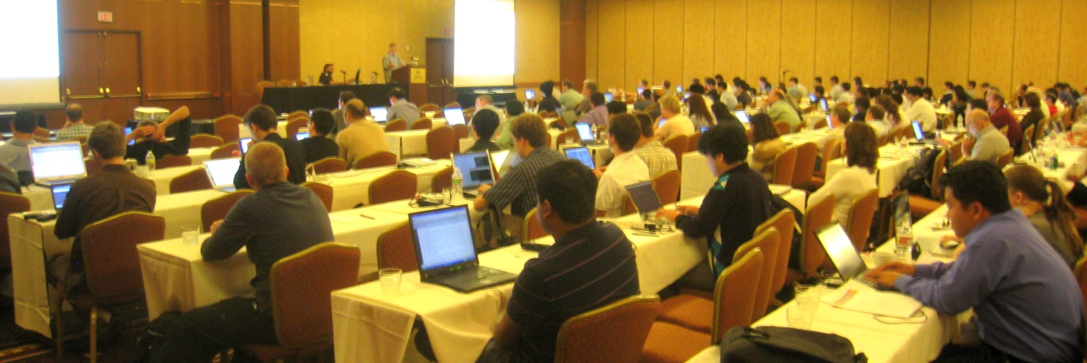
GENI Engineering Conferences
We welcome your participation in GENI
22nd meeting, open to all:
March 23-26, 2015, Washington, DC
  Planning & discussion for experimenters, software, infrastructure
  Tutorials and workshops
  Travel grants to US academics for participant diversity
Notes:
25

Slide 26

Ways to Get Help
Sign Up for :
  geni-users@googlegroups.com
Use #geni IRC chatroom
HowTo pages on the GENI Wiki
http://groups.geni.net/geni/wiki/GENIExperimenter/GetHelp

Slide 27
Other Important Lists
geni-announce
  GENI news and events
Experimenters
  Announcements of interest to GENI experimenters
Experimenter-ops
  Announcements about infrastructure maintenance
Full list at:
http://groups.geni.net/geni/wiki/GENICommunicationChannels

Slide 28
Questions?

